Slide 1
SONYC Assembly and Test

Slide 2
Pre-assembly

Slide 3

Test microphone function
Plug in mic to MCHStreamer and record snippet of audio on your machine. Play back to make sure recording is clear with no artifacts.

Slide 4
Flash SD cards
Flash SD Cards and check it boots with SONYC code.
- download and install the necessary packages (ansible, hellolan, git clone ht.., ...)
- download rasbpi os
- repeat for all SD cards
- insert sd card
- run python setup_sd.py --vars "uuid=$(randomname get),app_name=sonyc"
- the first time you will be asked for wifi credentials, and next time it'll be cached
- record the uuid value printed out on masking tape
- Run ansible setup script
- go to overview.master1.sonycproject.com
- turn on "freshly provisioned" filter to
- check:
- tun0_ip: is openvpn up and running?
- wlan0_ip: is wifi working?
- ap: is the wifi ssid correct
- mic_connected:
- lzeq: is spl working

Slide 5

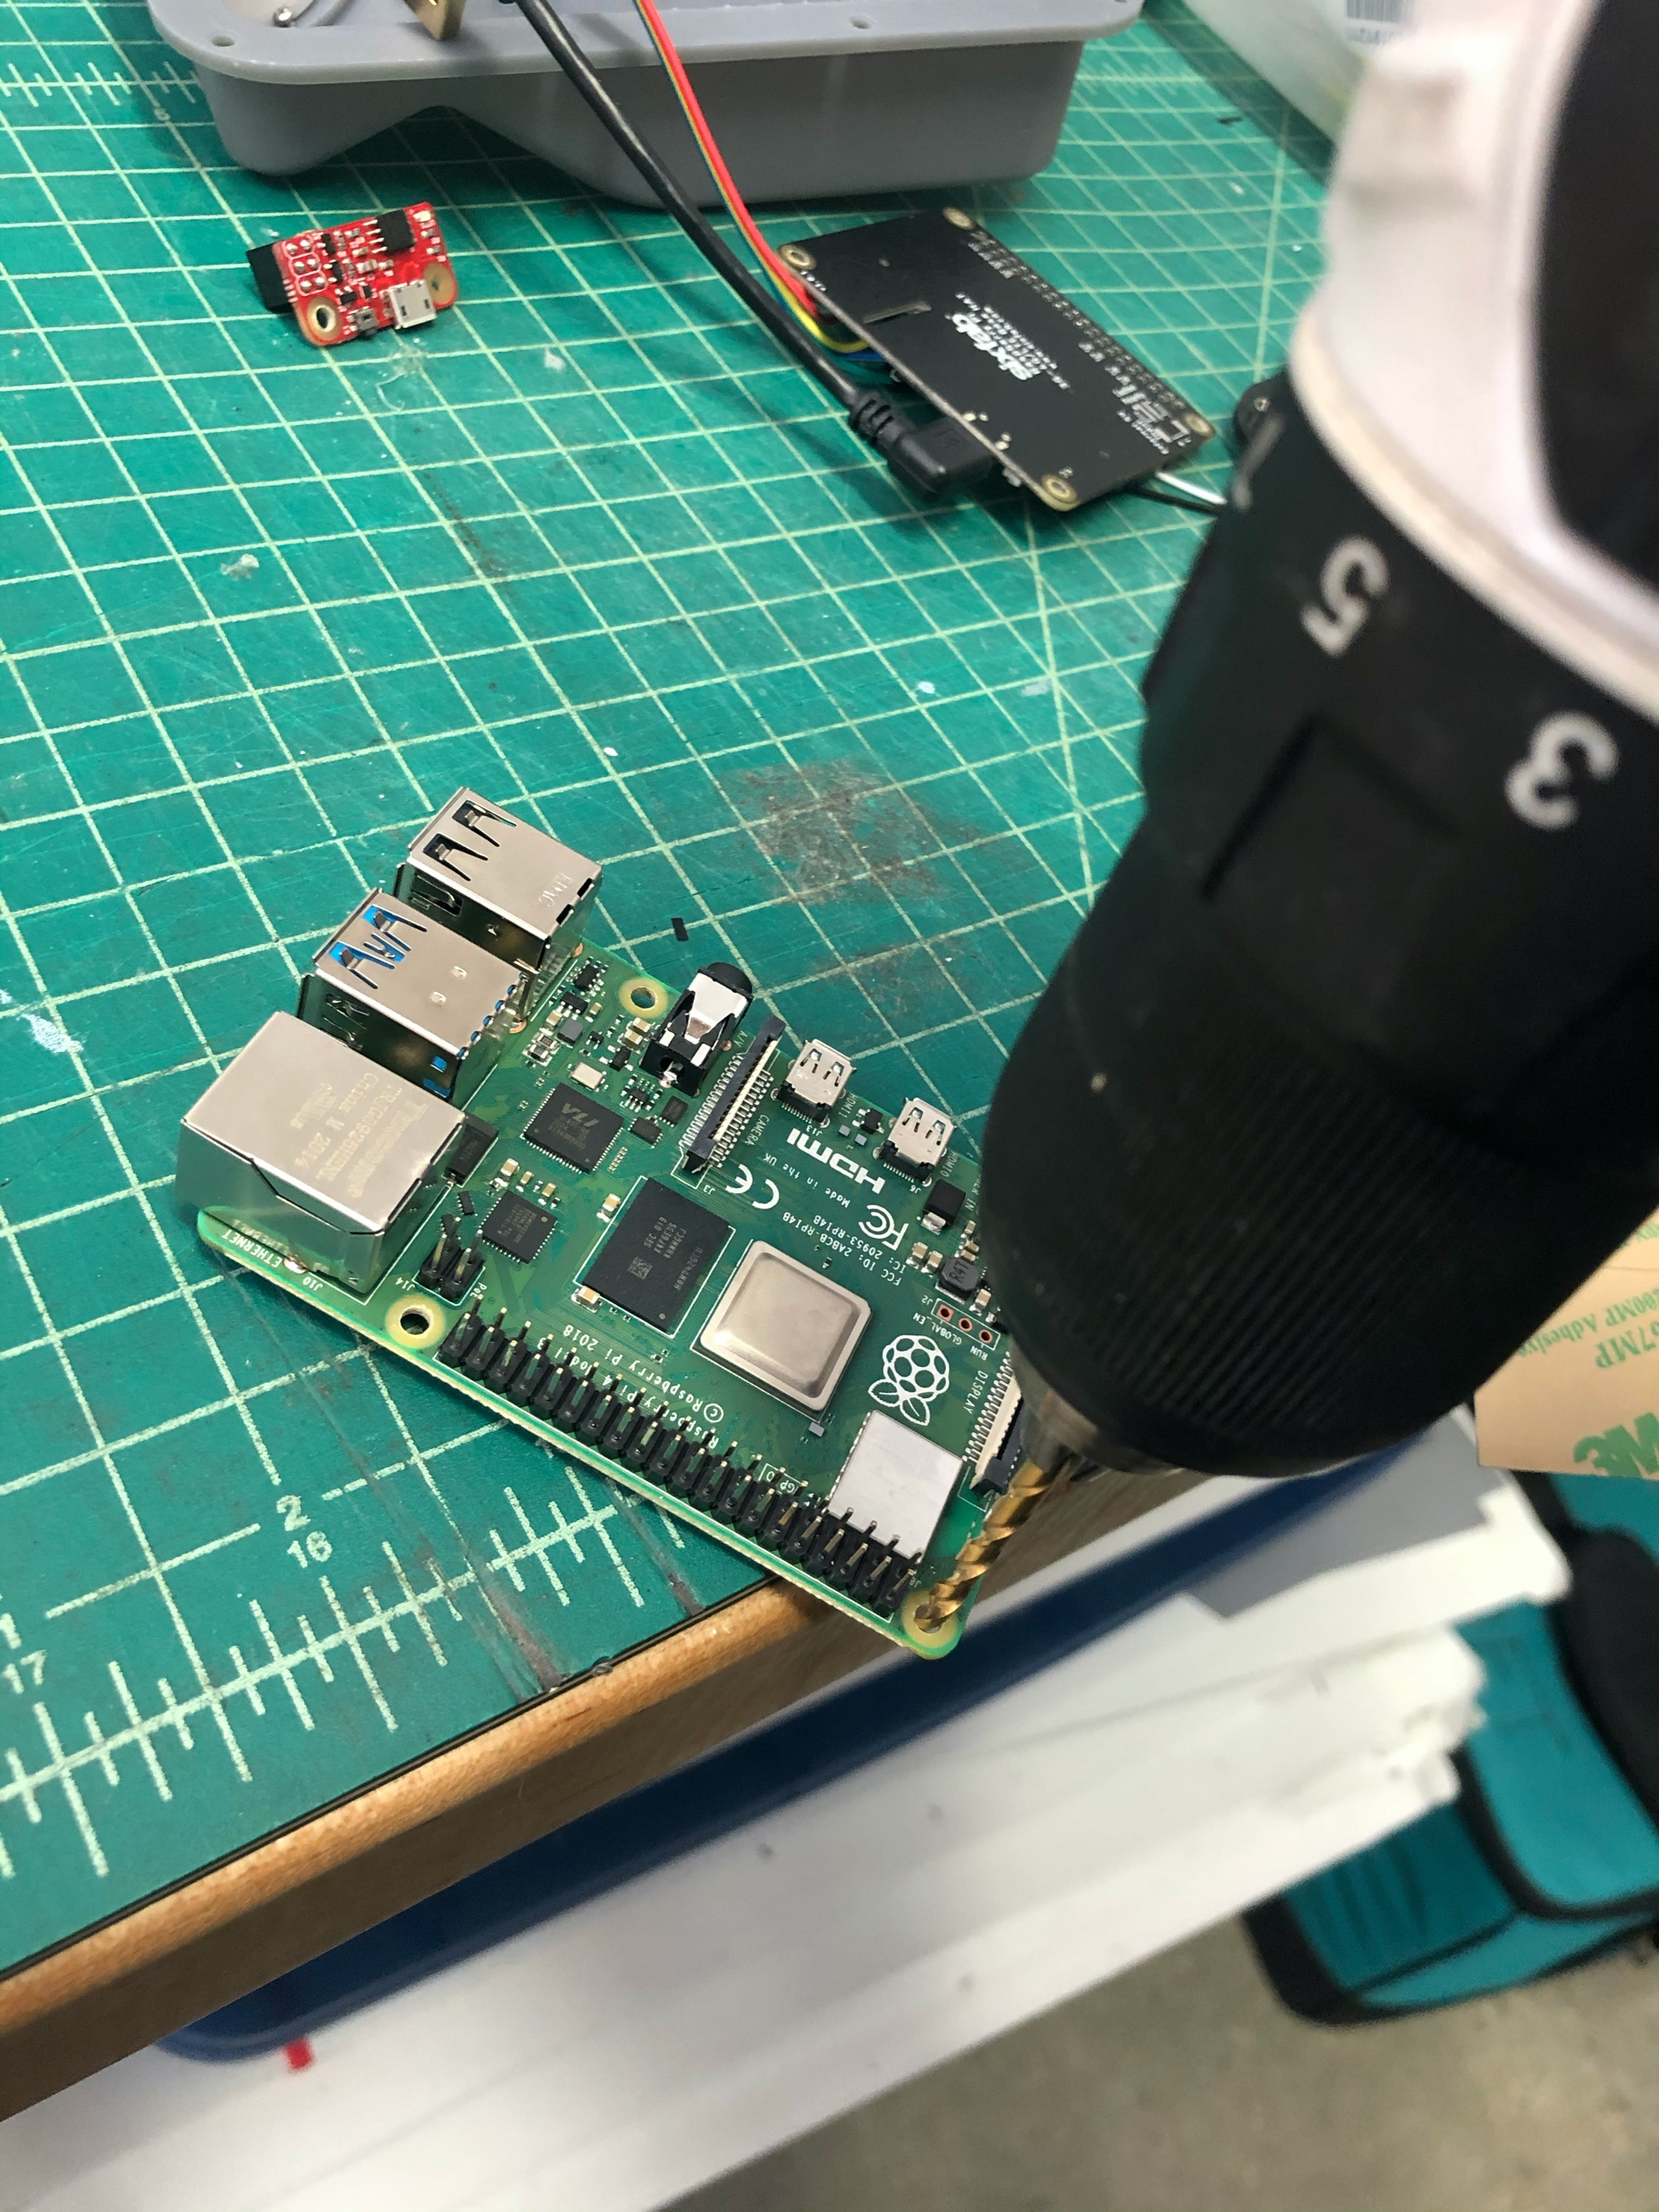
Drill all Pi, Piwatcher, and LTE hat holes to fit 4-40 thru hole (use a 1/8” bit)
Clean with compressed air

Slide 6
Assembly

Slide 7
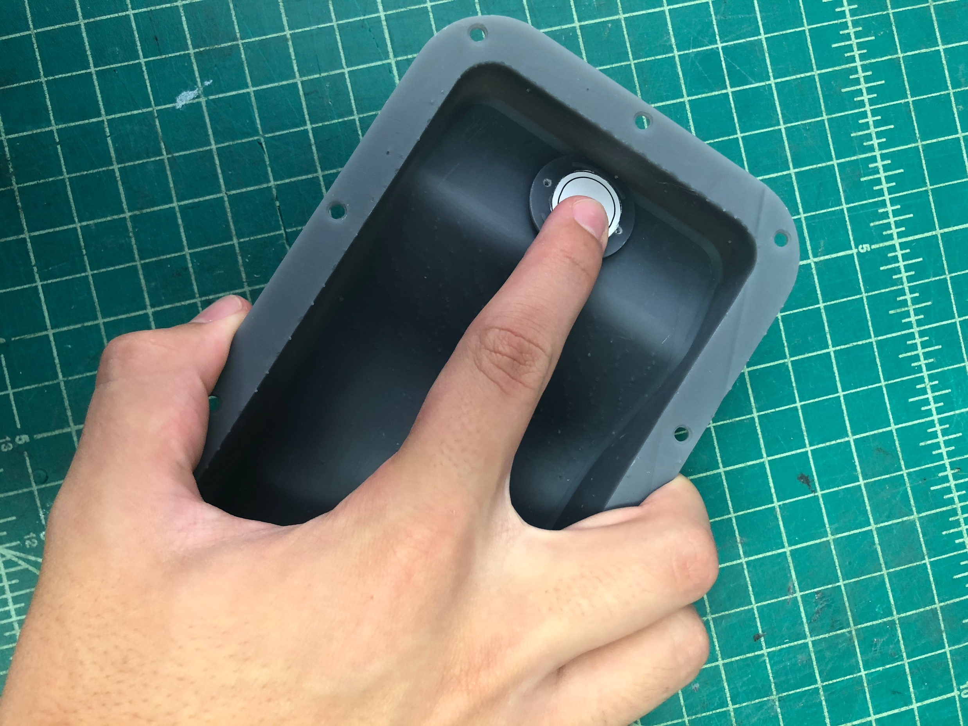
Place water membrane over microphone hole. Use 2 pairs of tweezers and place carefully to avoid touching adhesive. Press around the edge to adhere

Slide 8
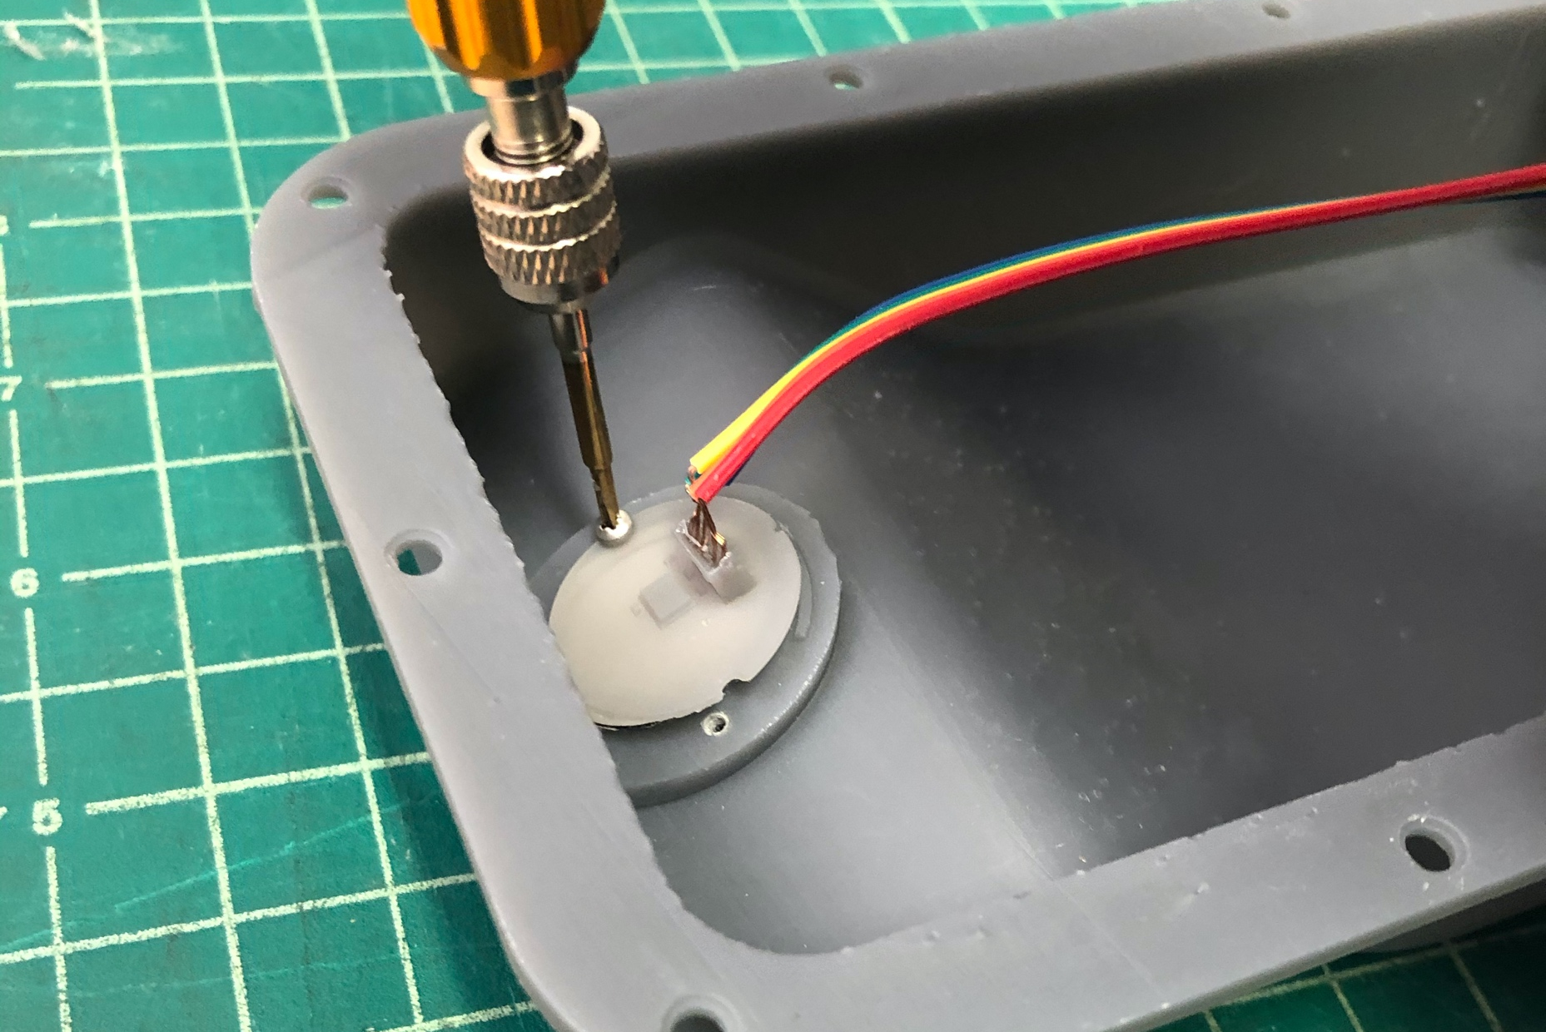
Screw in microphone PCBA

Slide 9
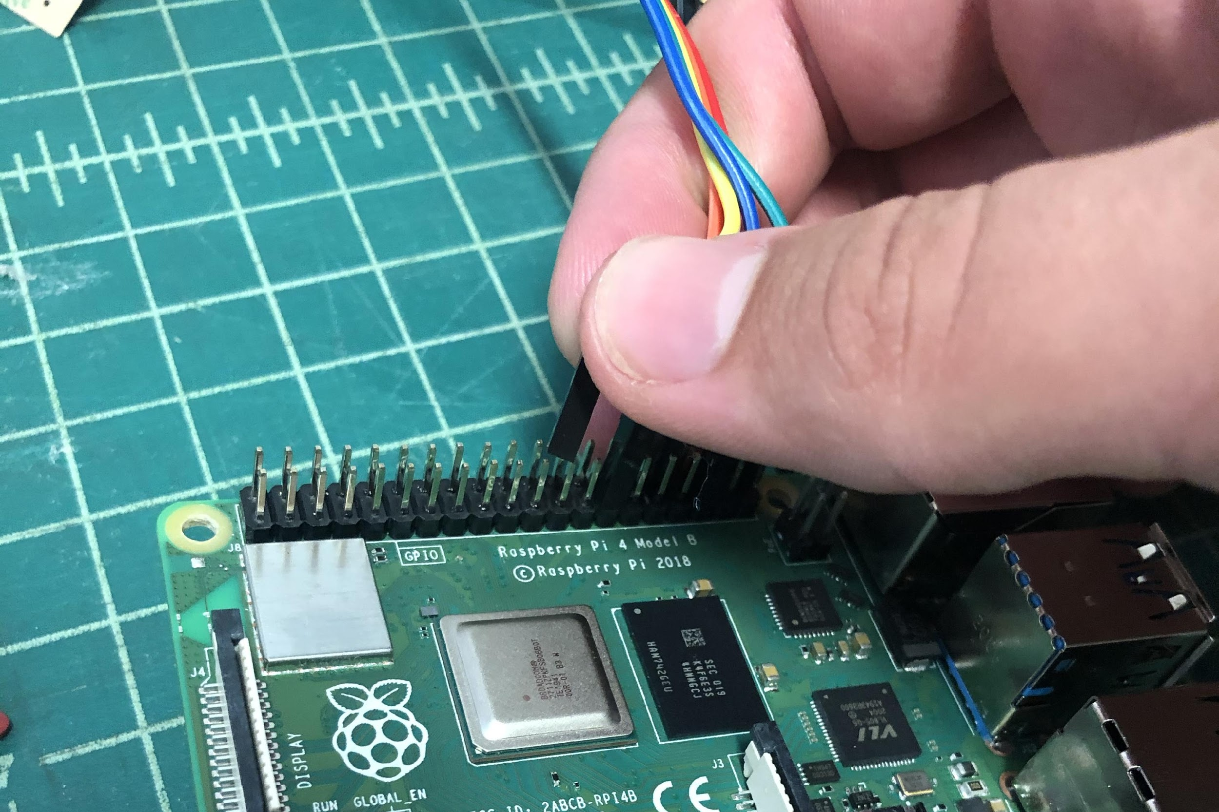
Plug microphone cable into raspberry pi
Use jig to tell which pins to go into

Slide 10
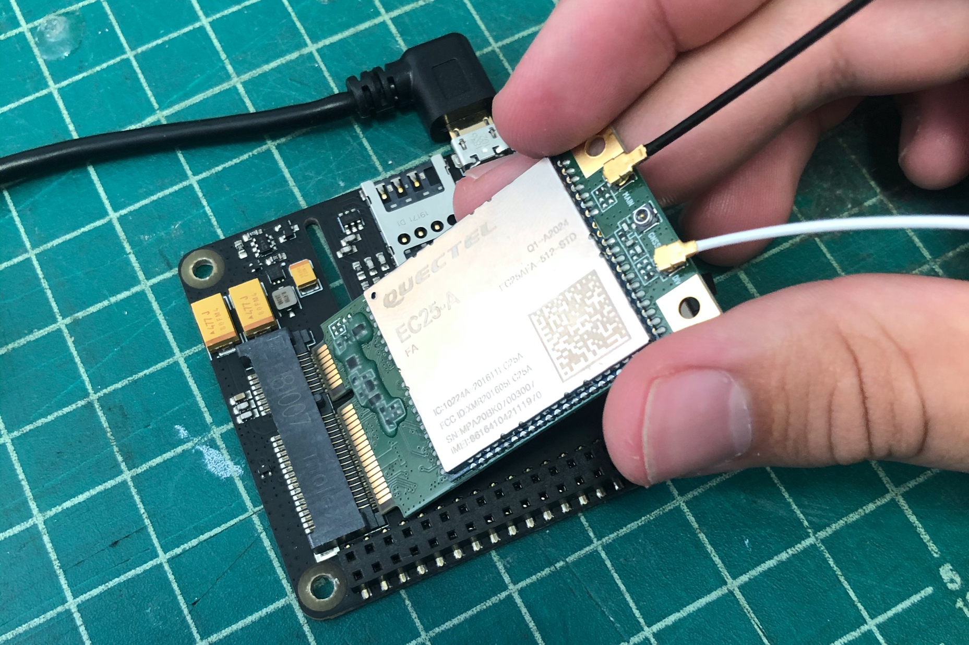
Plug antennas and LTE chip into cell hat

Slide 11
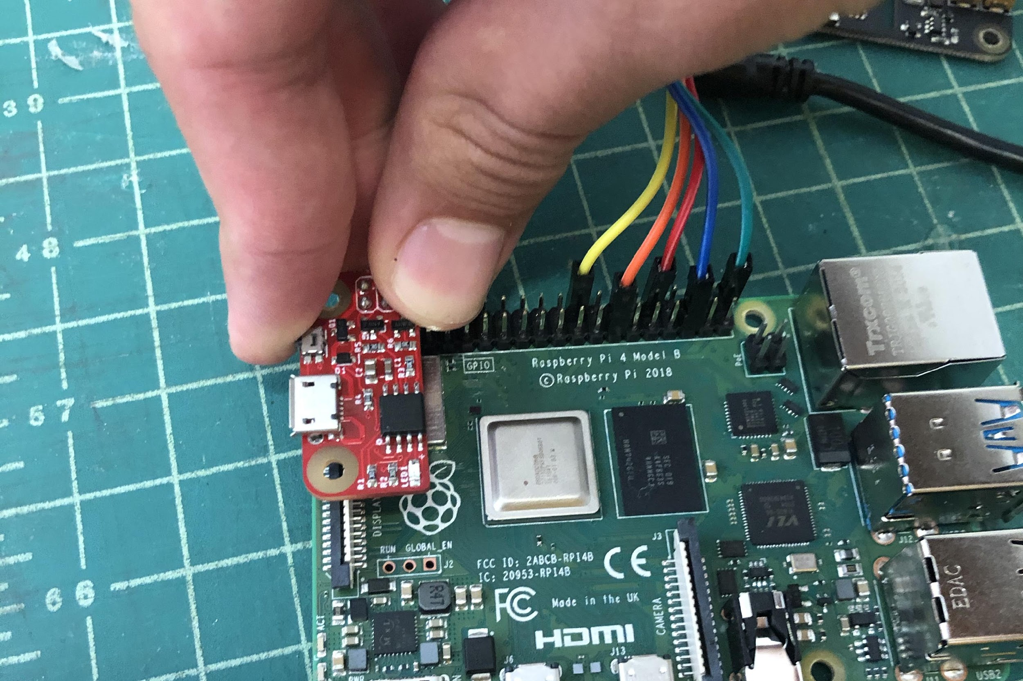
Plug Piwatcher into the Pi Place a 7/16” spacer between the Piwatcher and Pi to support

Slide 12
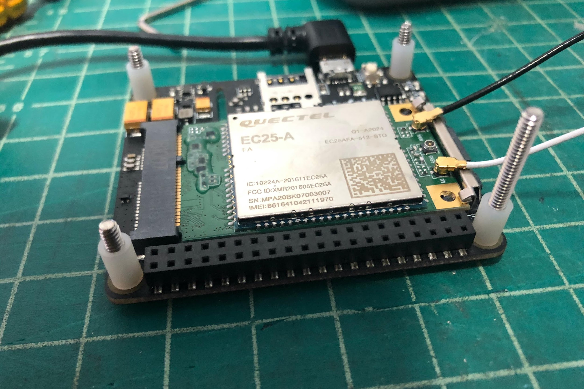
Place Cell Modem face up, with screws coming upwards through the holes. The long screw (1 1/8” long) goes on the bottom right corner (as shown).
Put 5/16” spacers on screws

Slide 13
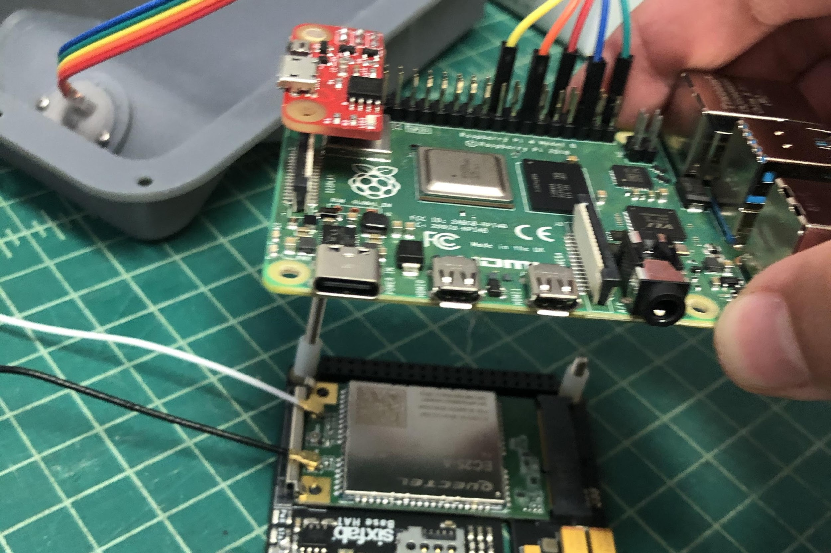
Put raspberry pi over screws on LTE hat (face up) and secure with o-rings ensure Piwatcher spacer catches long screw

Slide 14
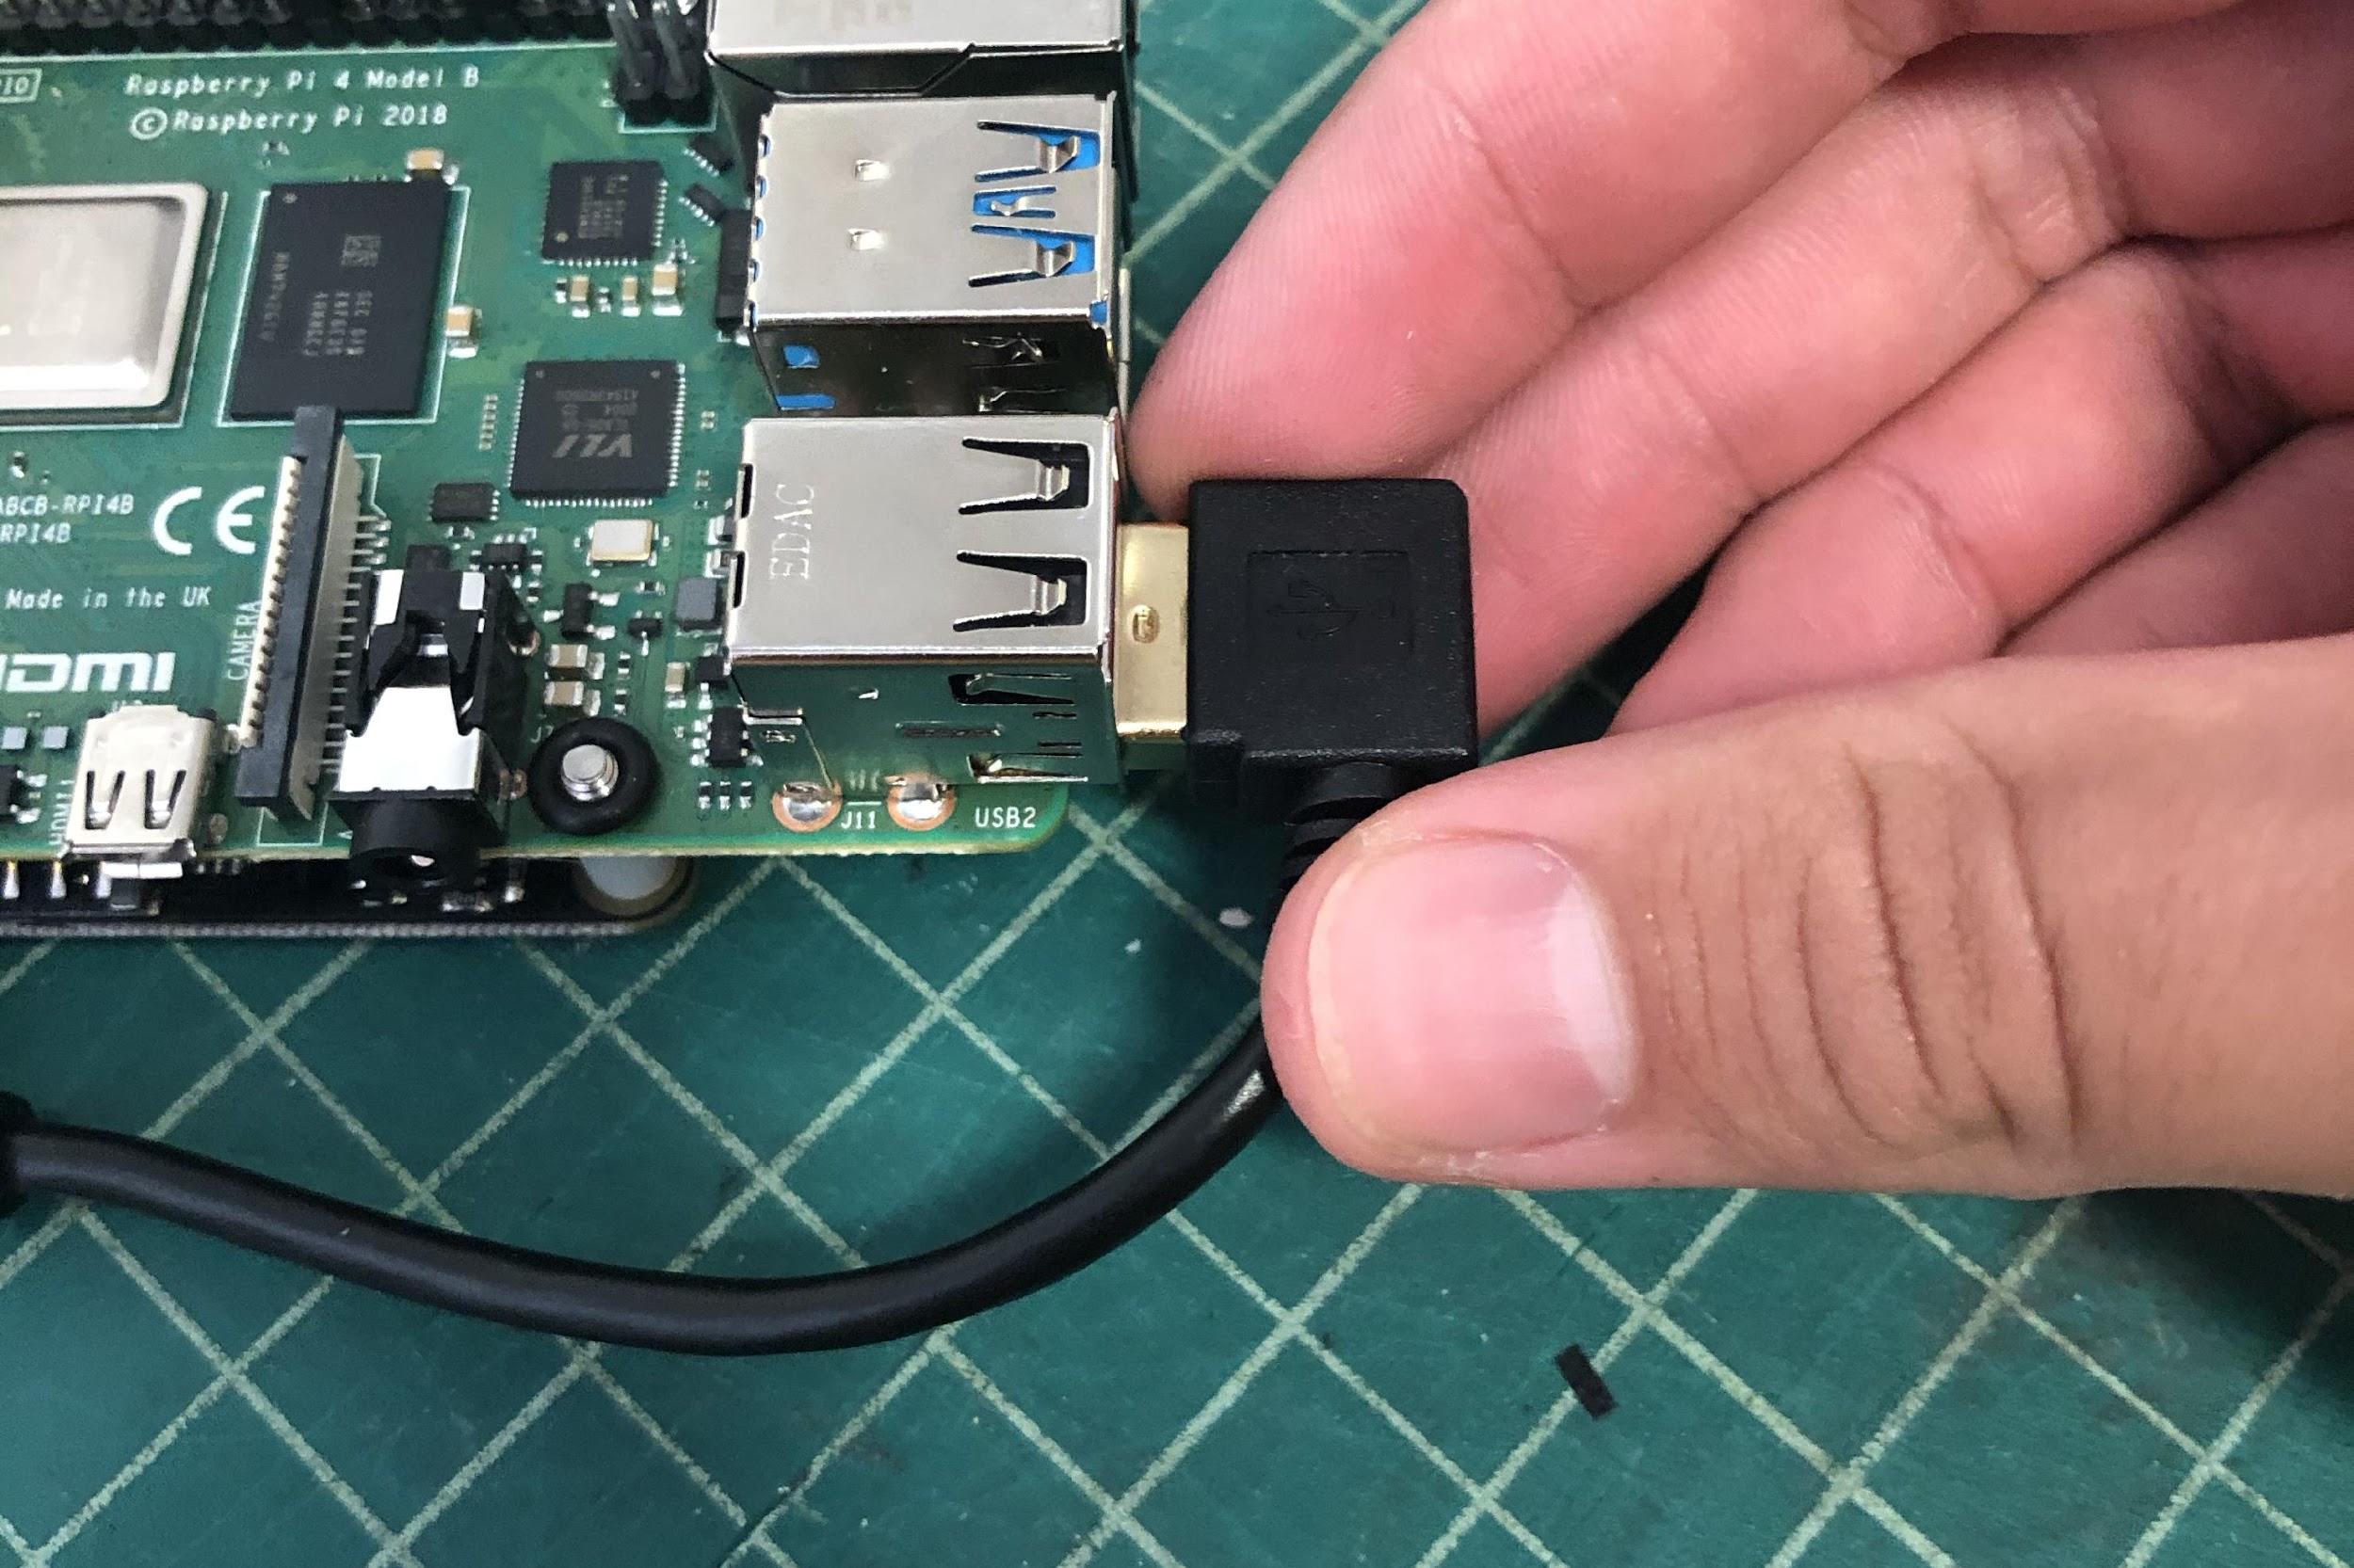
Connect LTE hat to Pi with right angle USB/Micro-usb cable. Plug it into the bottom right USB port (photo shows wrong one)

Slide 15
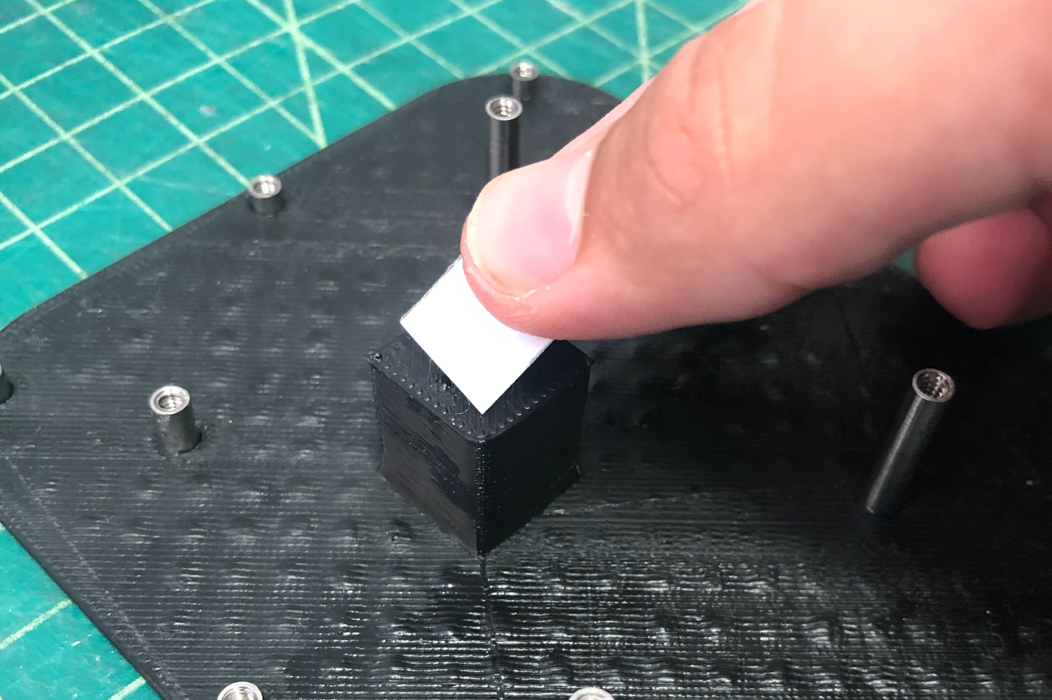
Apply heat transfer paste to heatsink block

Slide 16
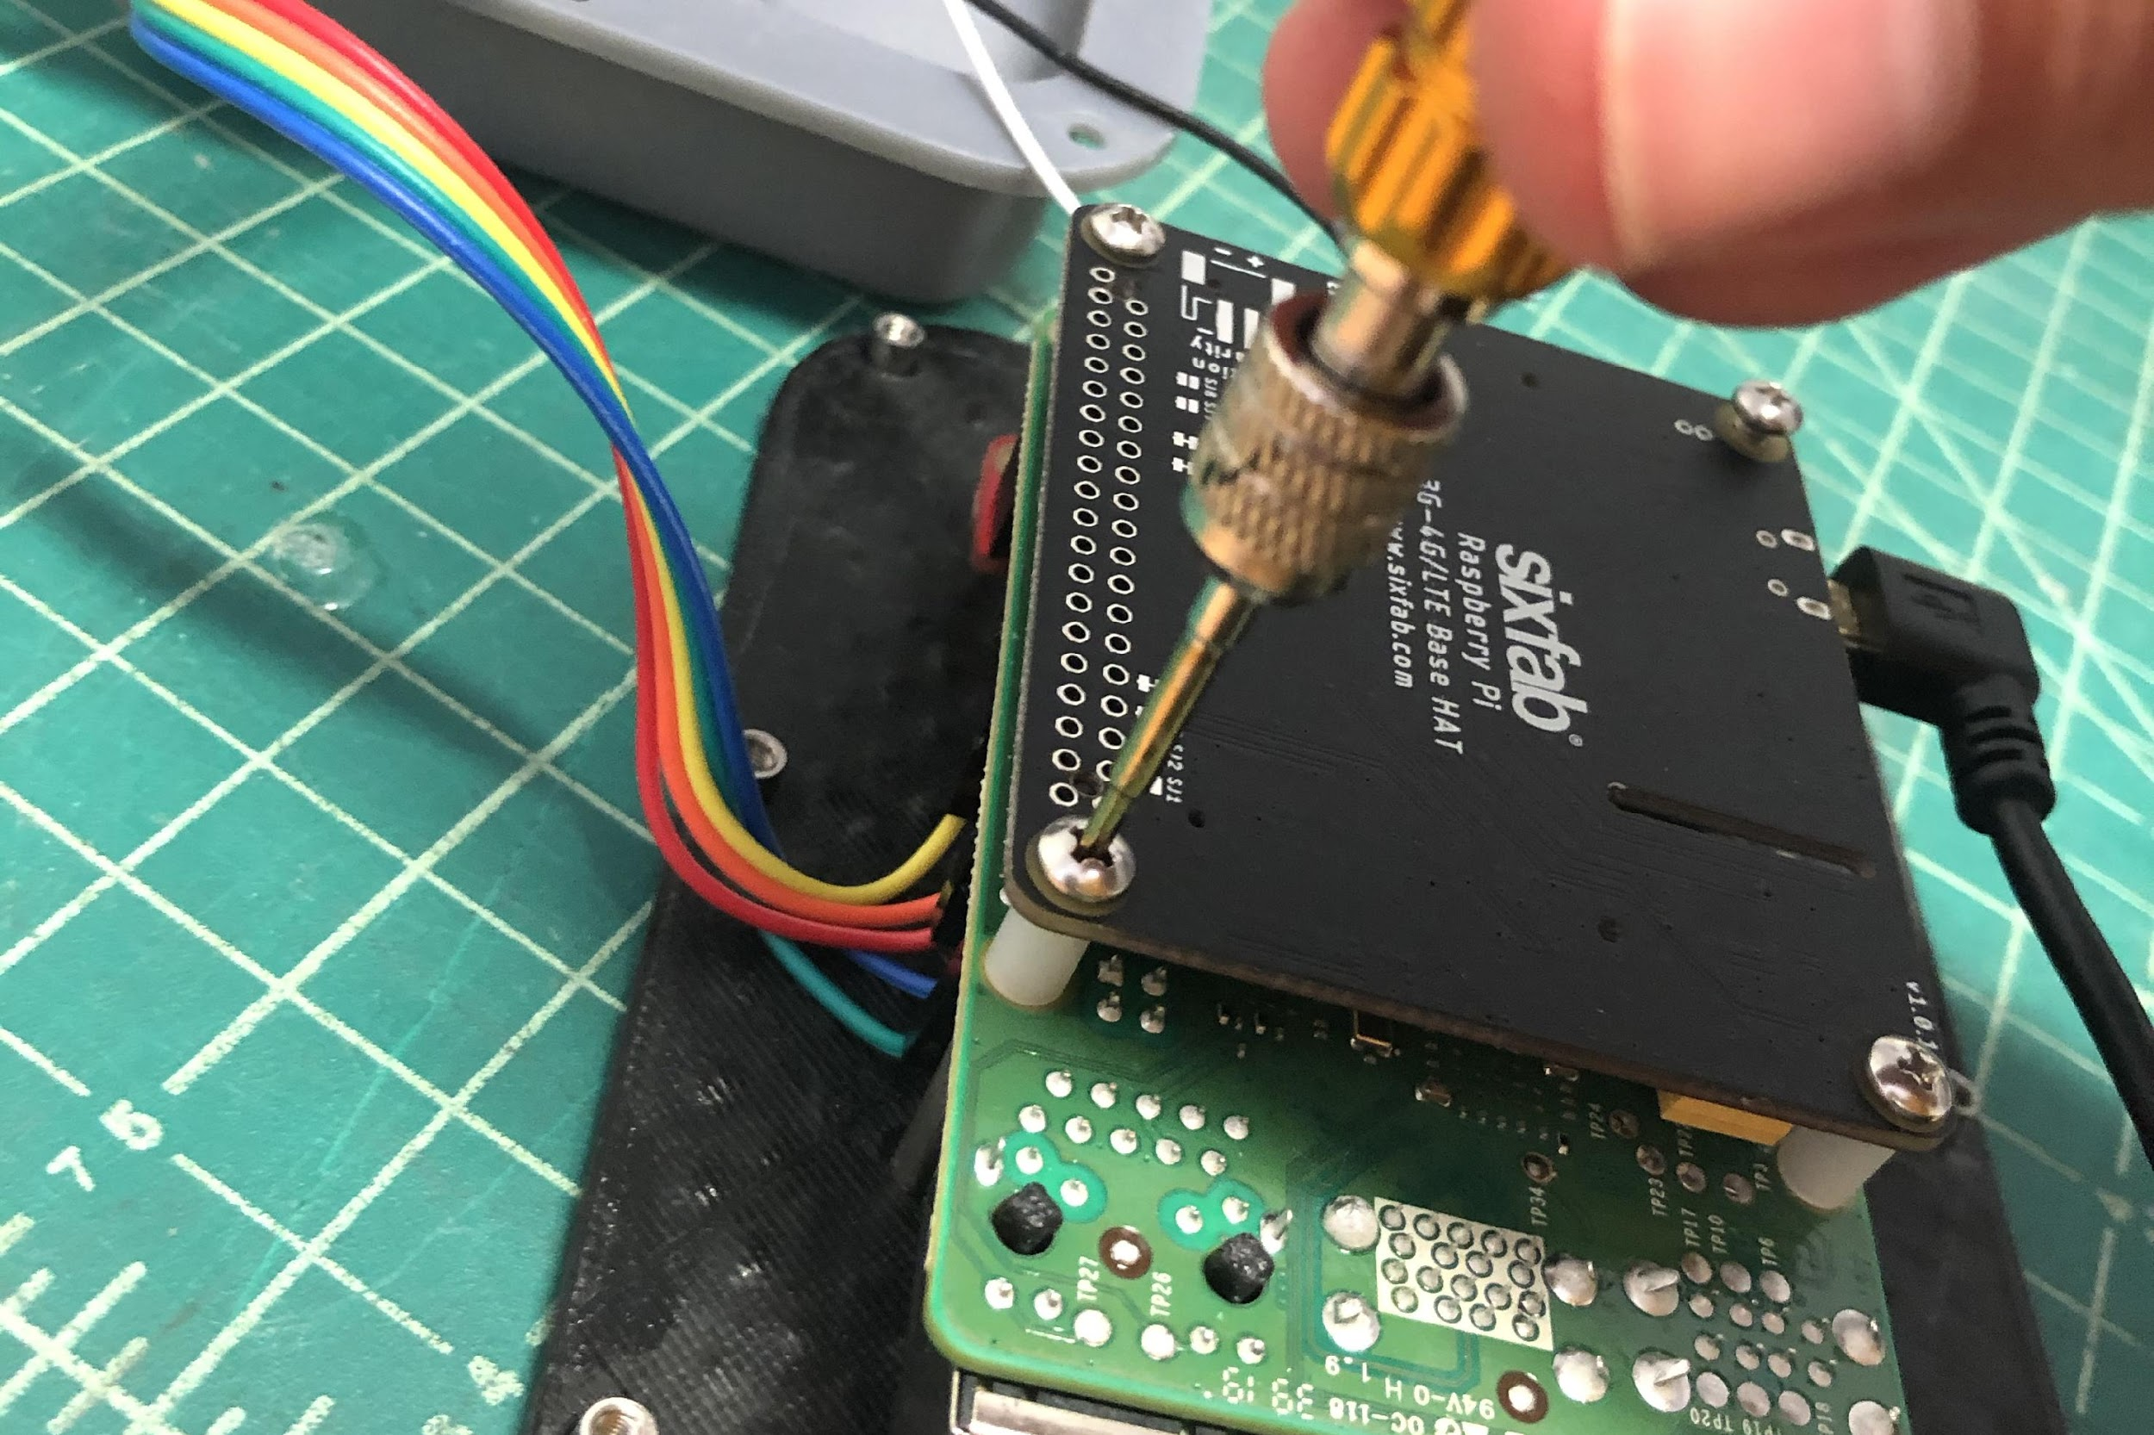
Put back plate over PCB stack, flip, and screw PCBAs into PEMs on back plate (all PCBs face “down” towards back plate)

Slide 17
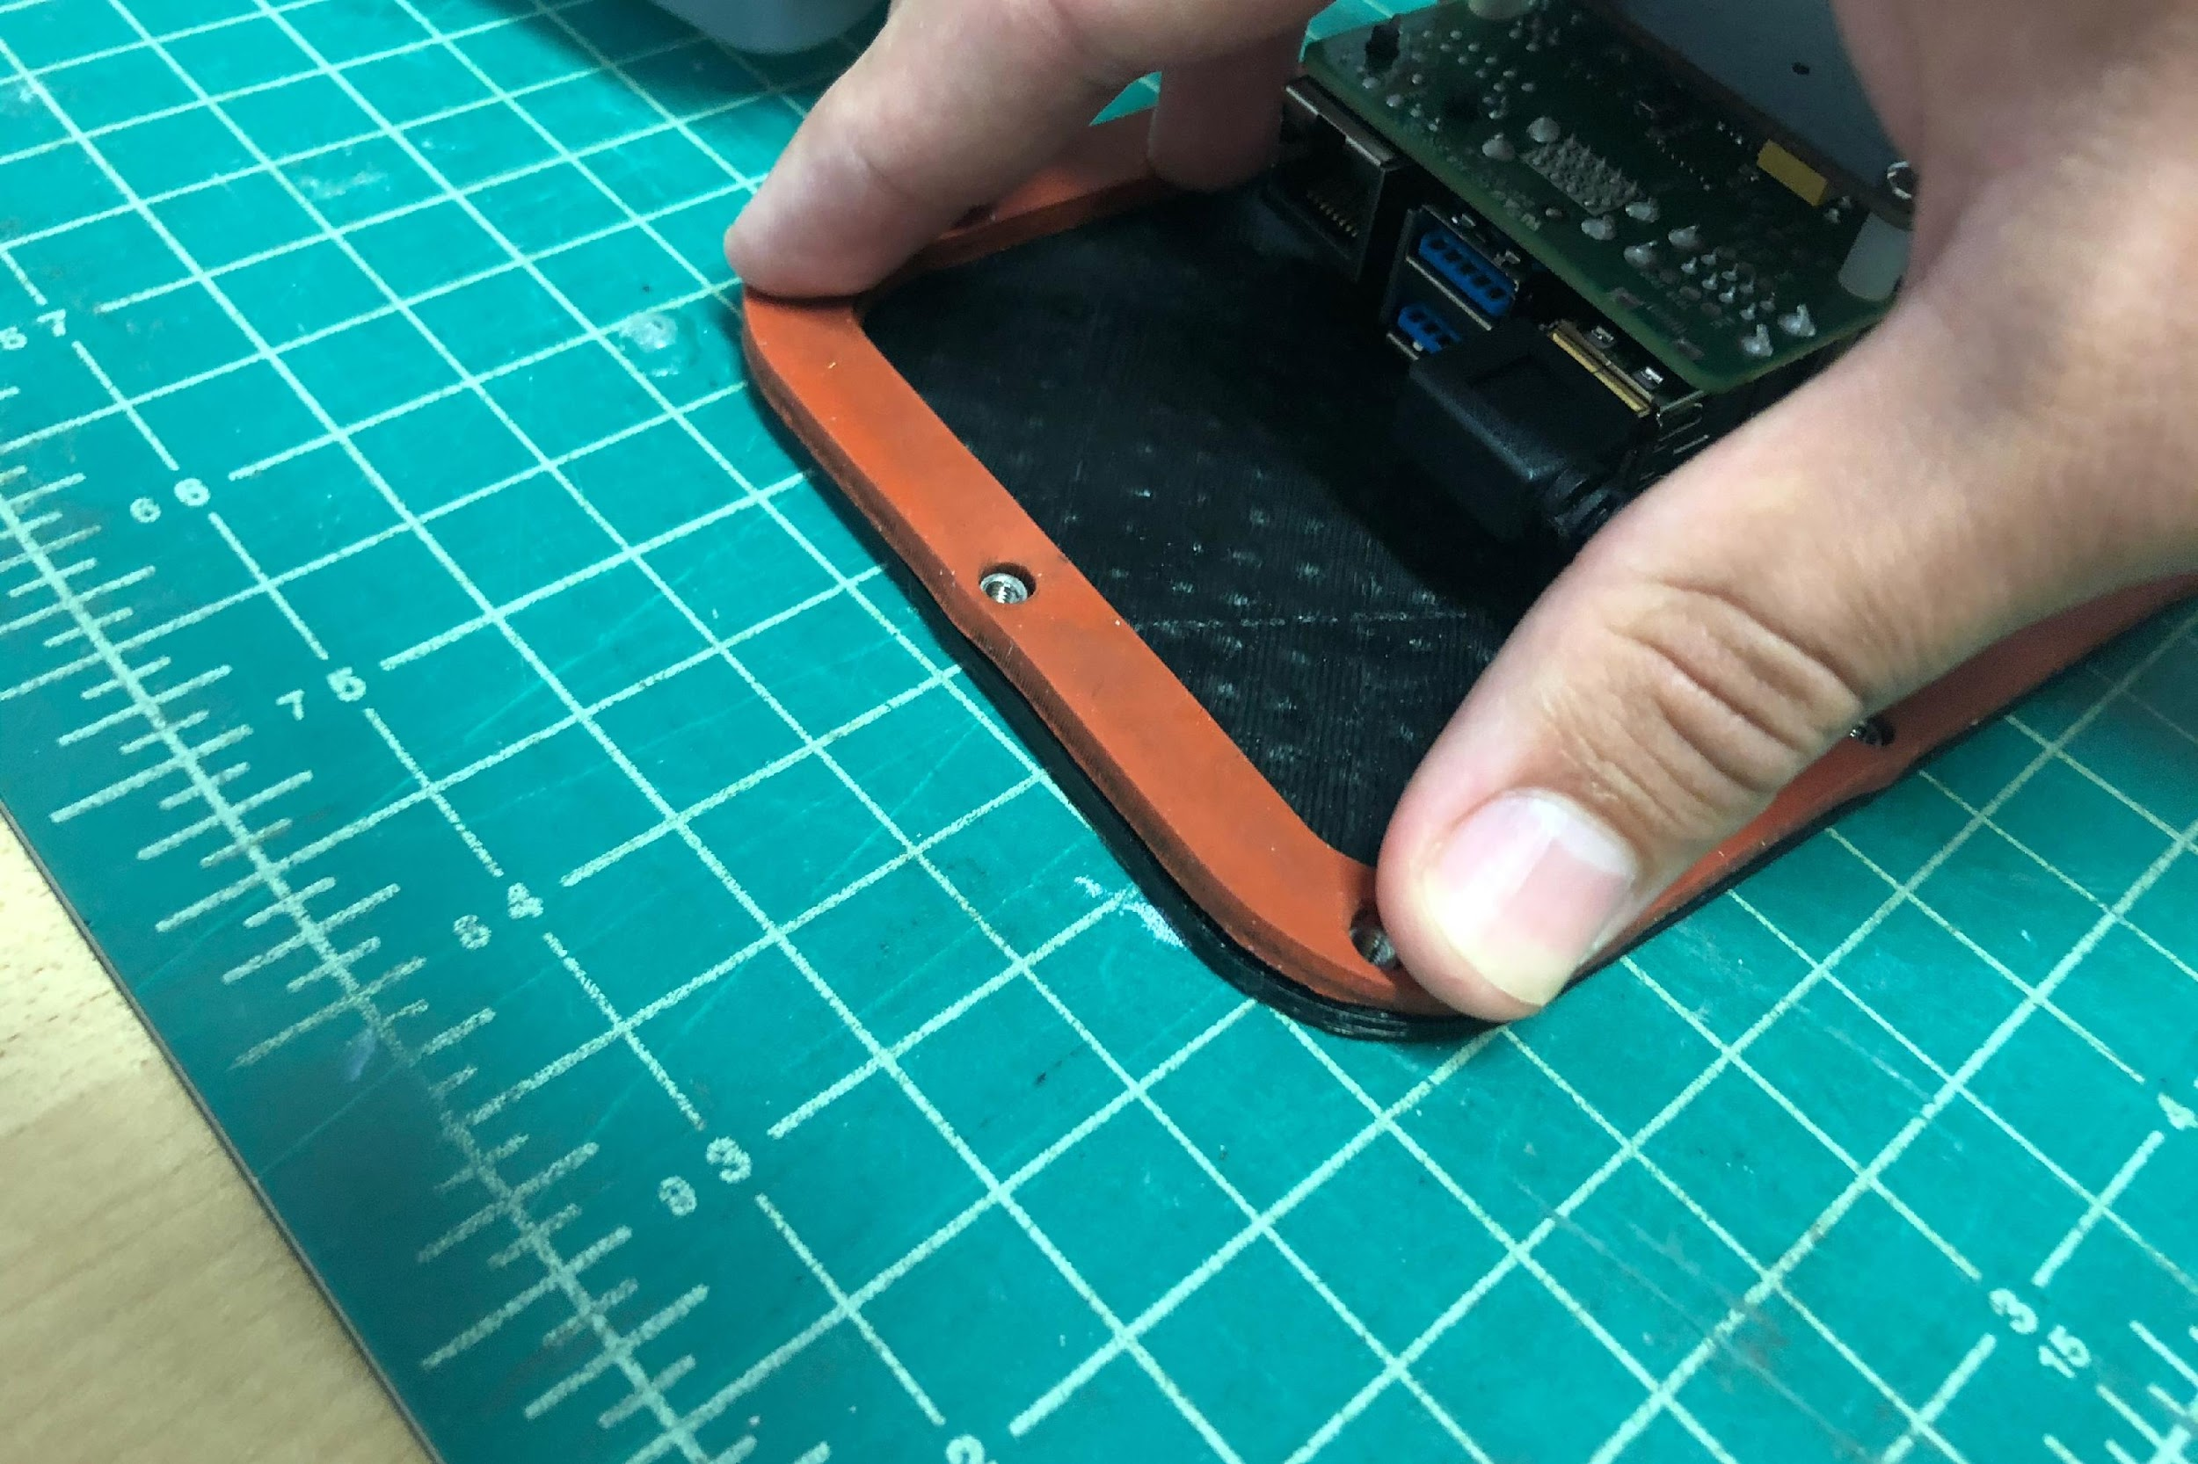
Place rubber gasket over back plate assembly

Slide 18
Adhere small gasket to front housing with double stick tape

Slide 19
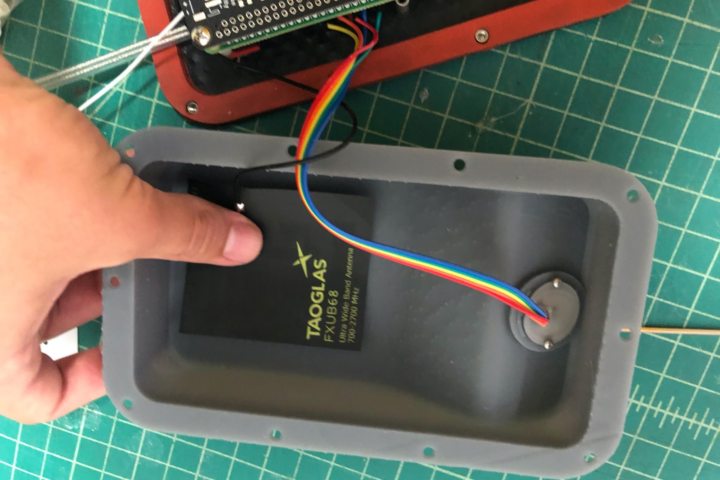
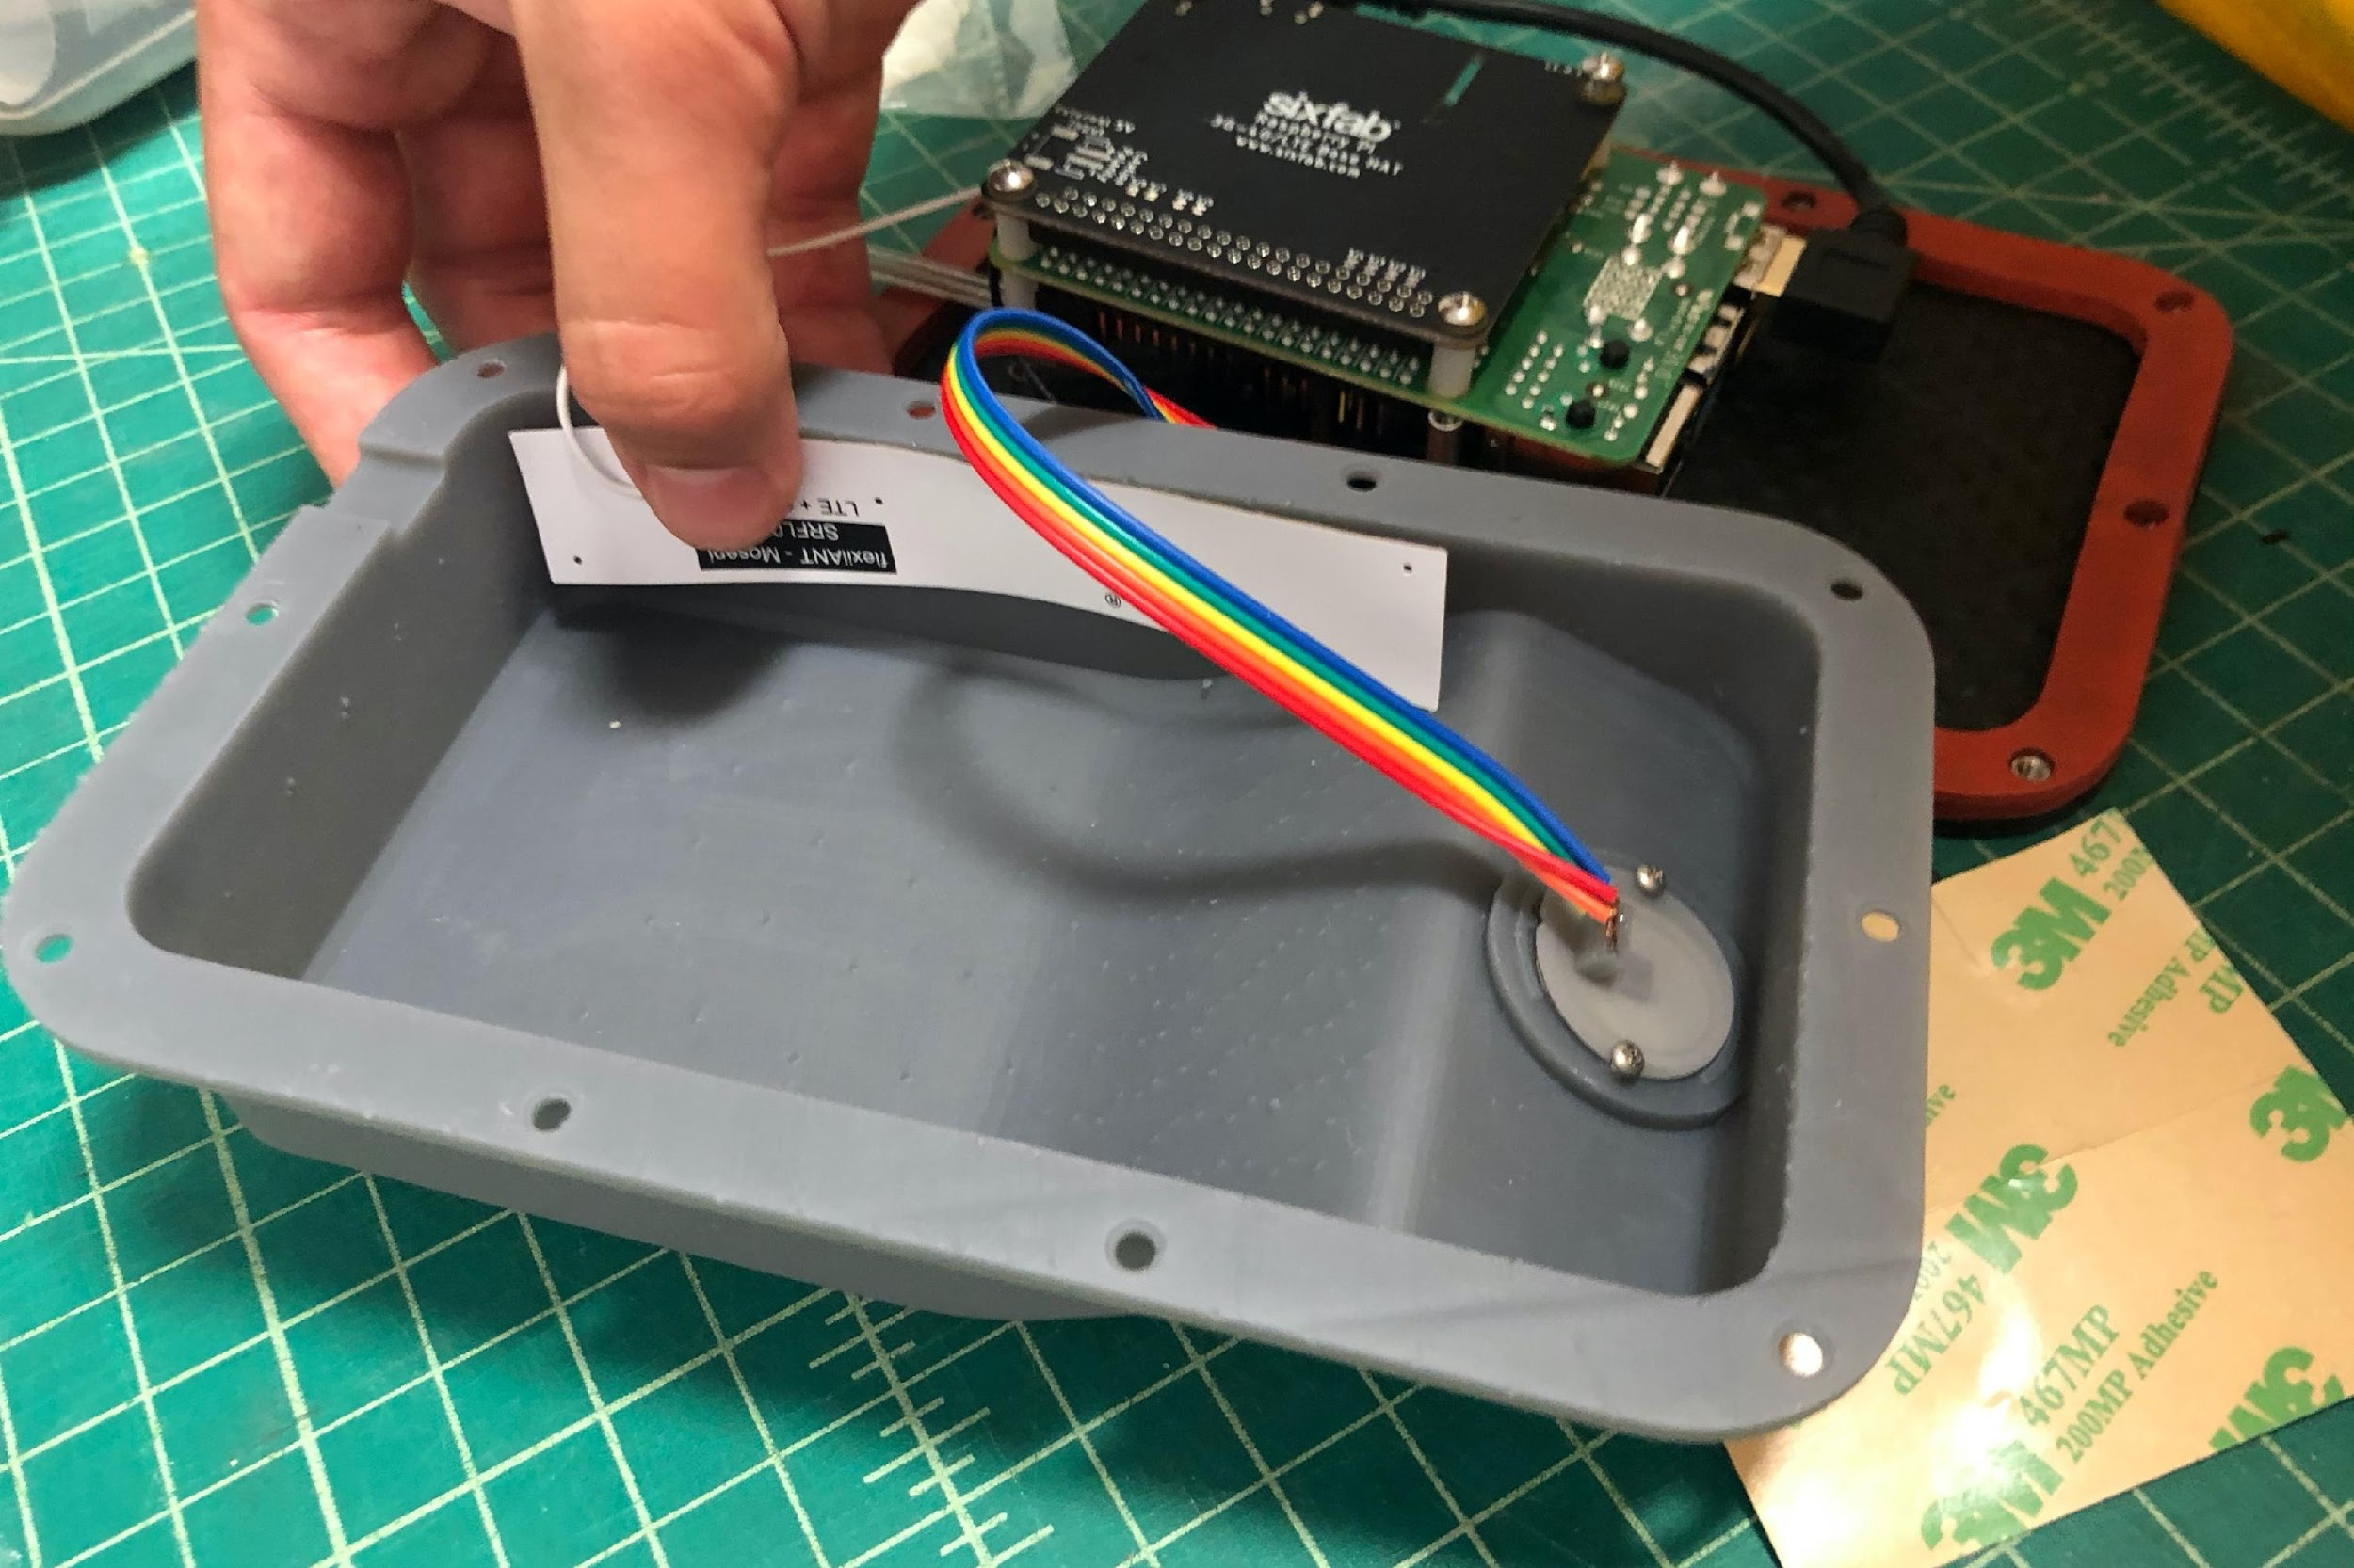
Attach antennae to housing as shown below
Main antenna is square-ish, goes on the back face (black wire). Route under white diversity antenna wire and secure cable to housing
Diversity antenna is long, goes on a side wall (can be bent to fit) (white wire)

Slide 20
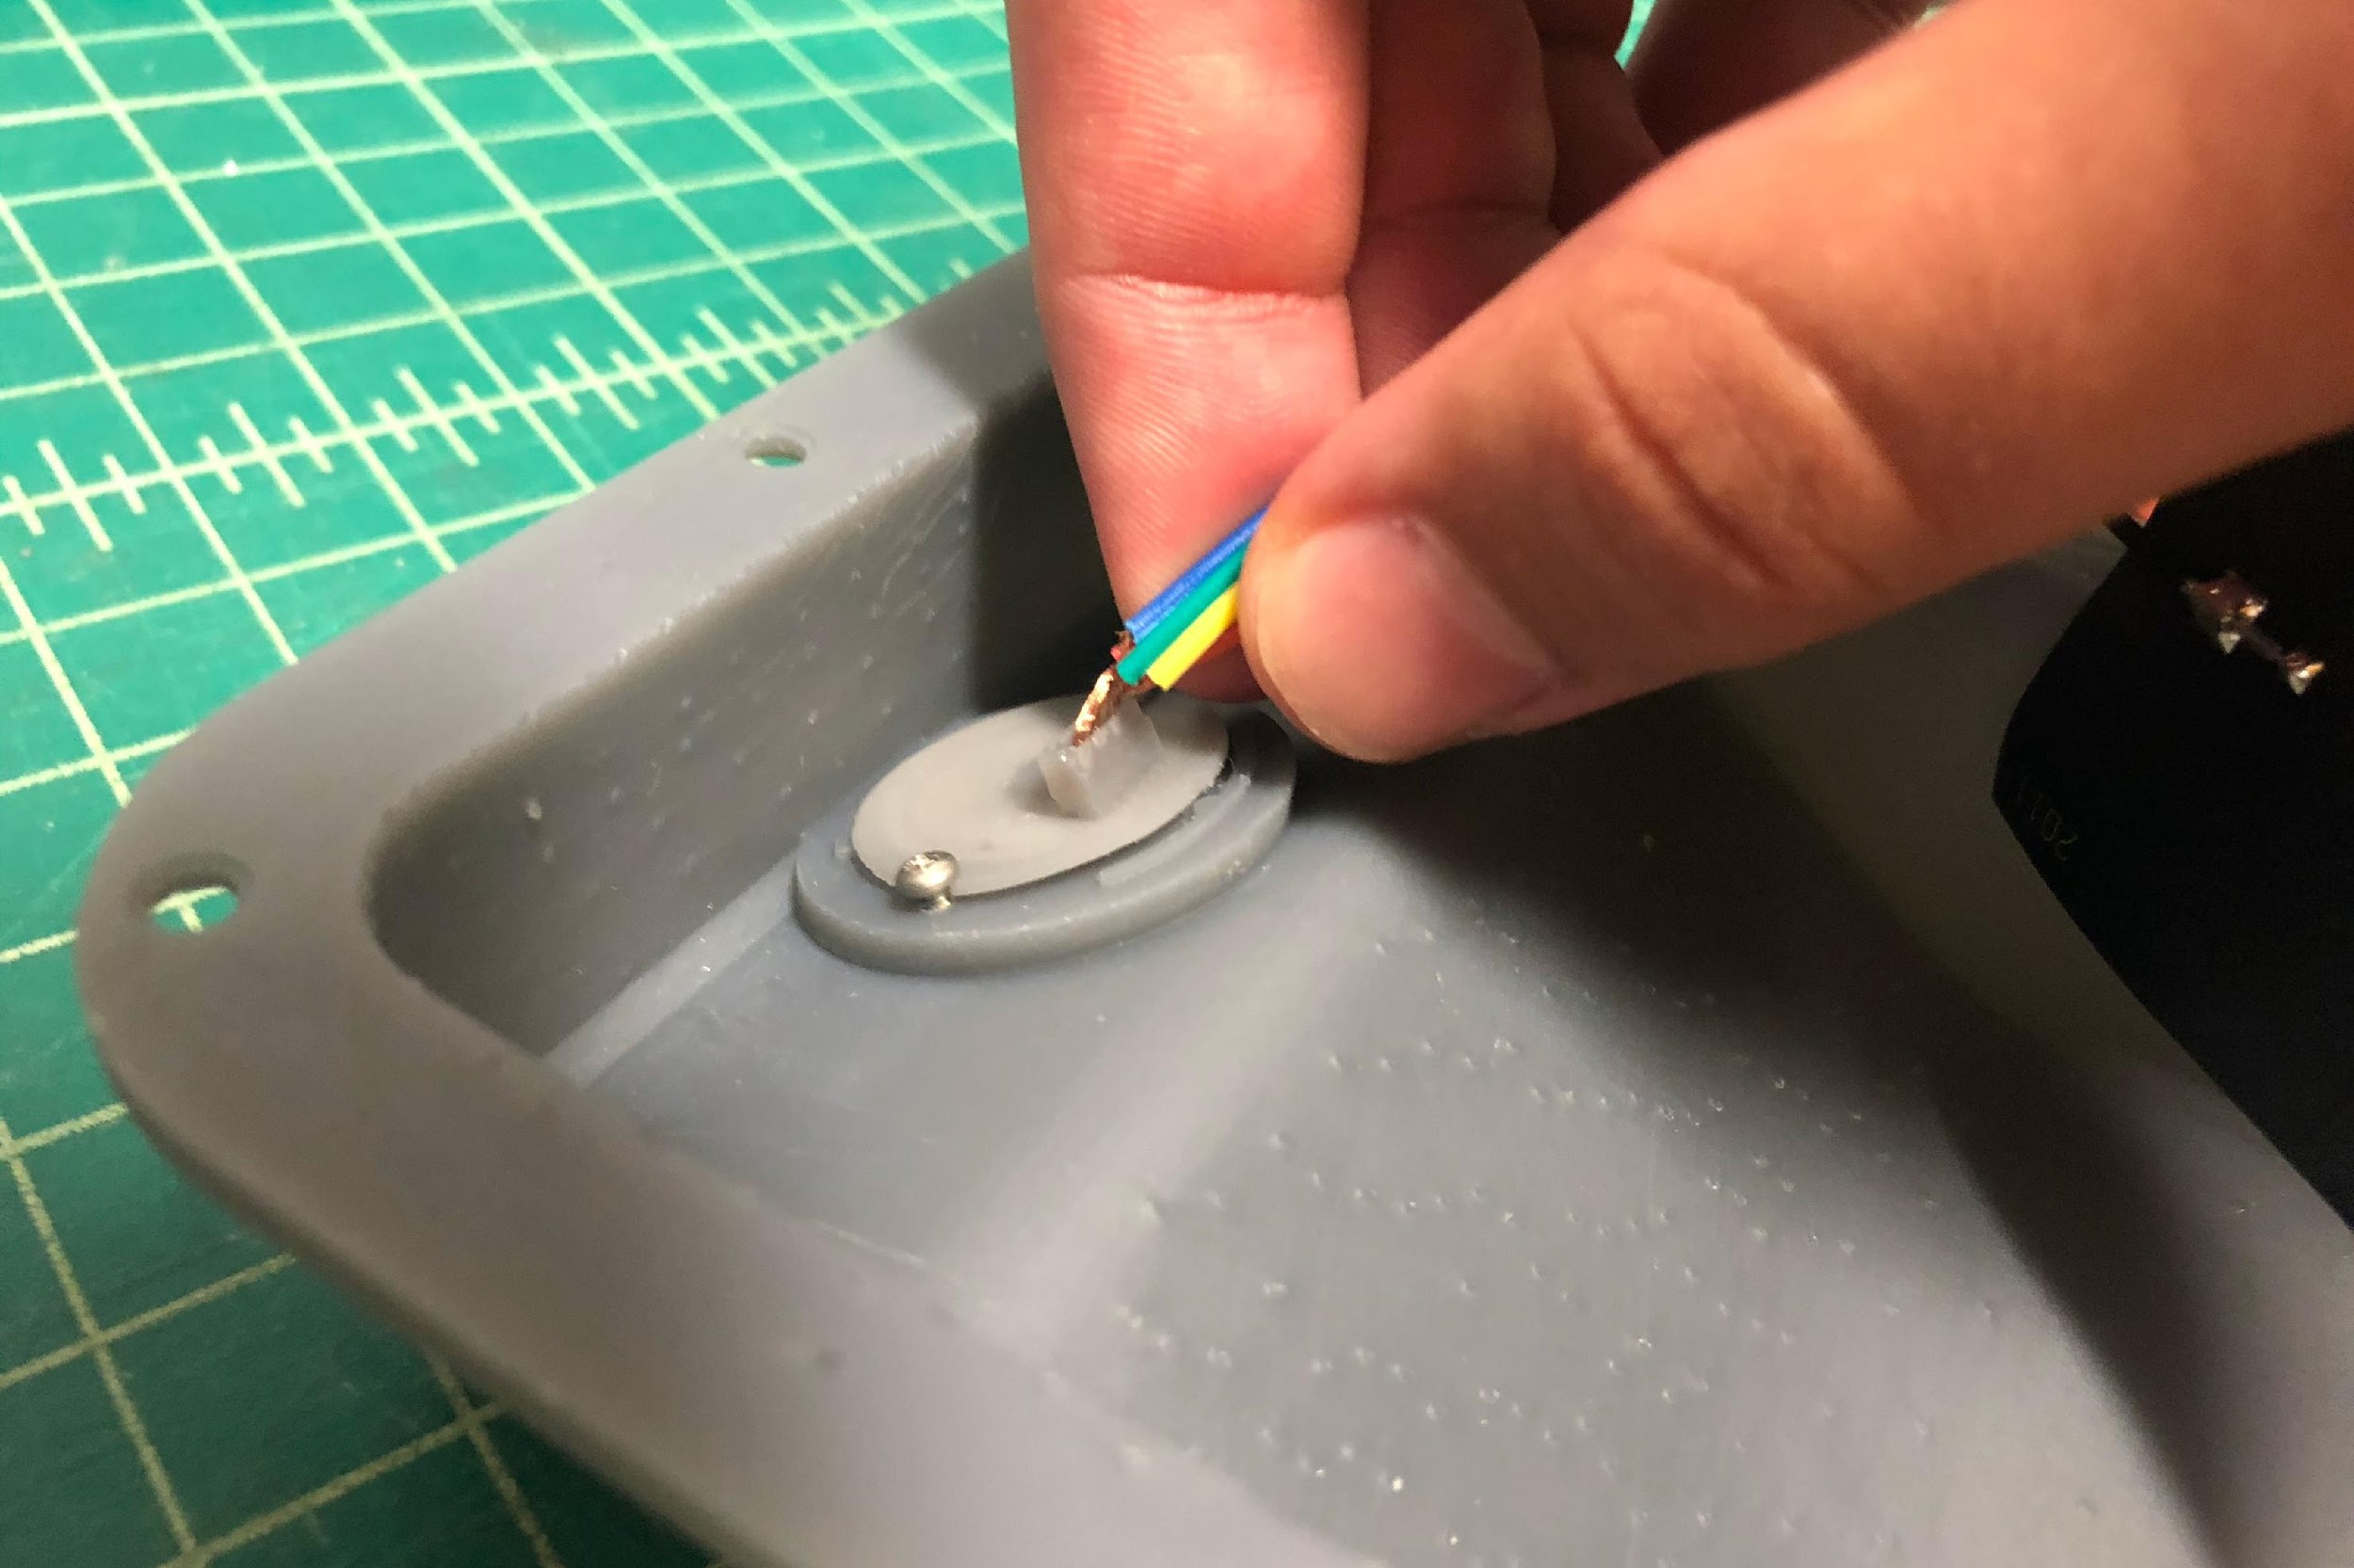
Twist mic cable wires, rout away from GPU and close to housing. Plug microphone cable into microphone PCBA

Slide 21
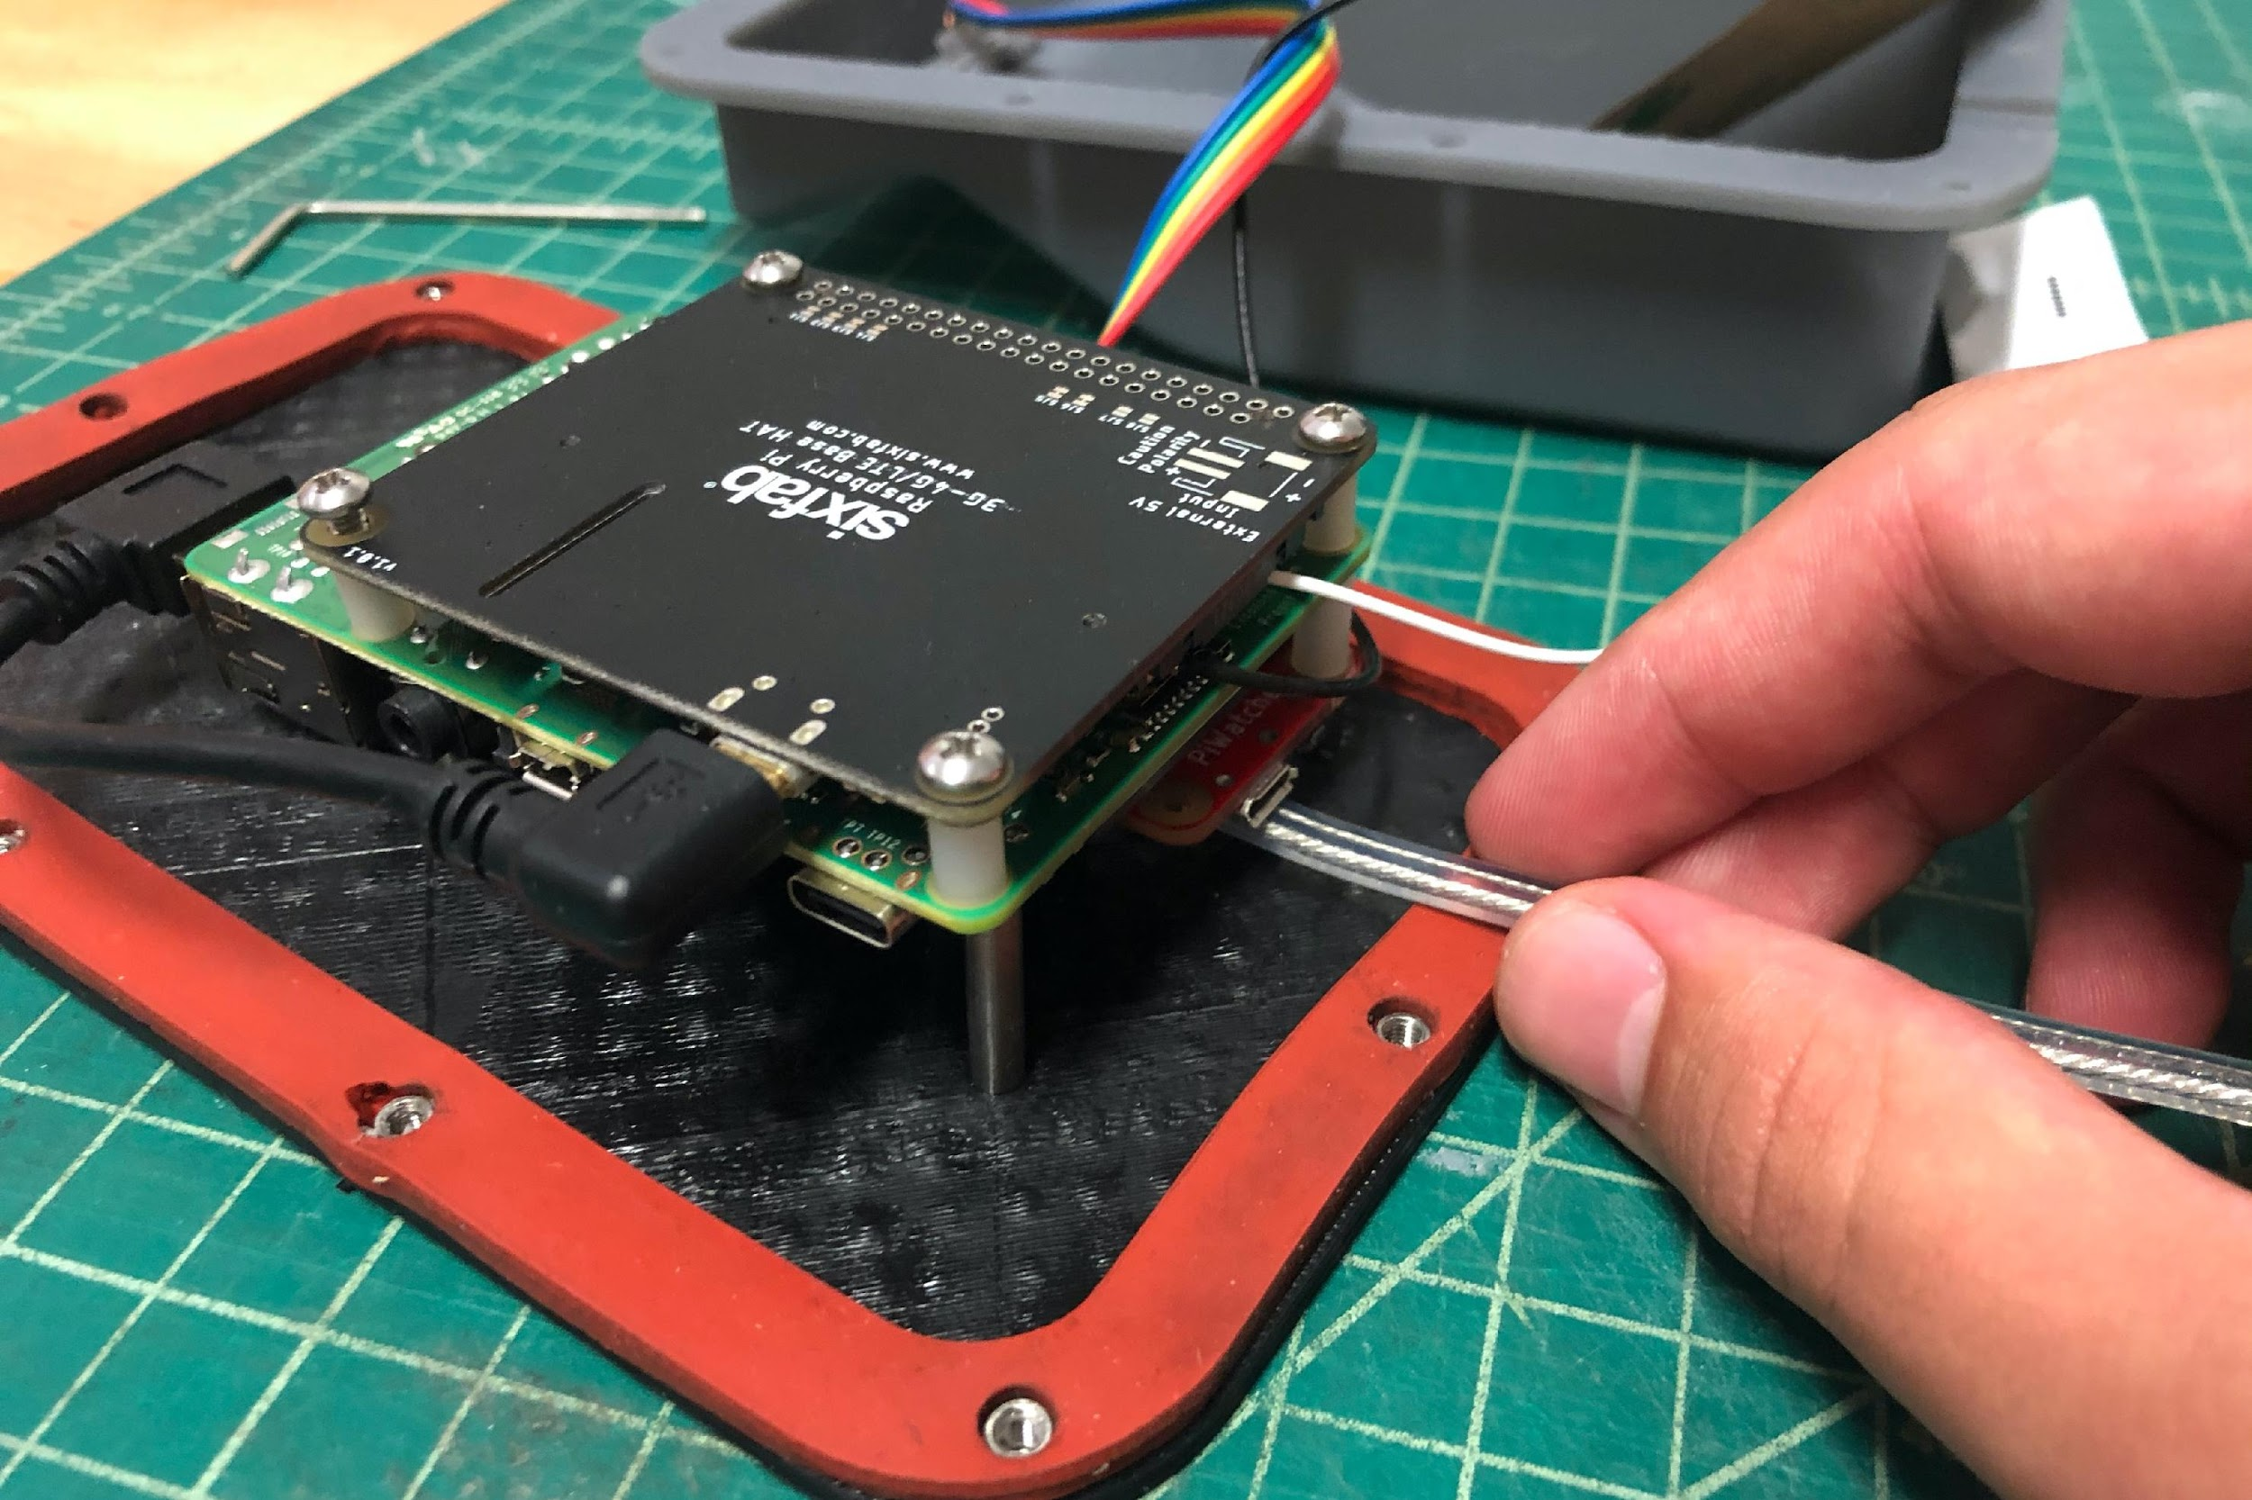
Plug power cable into Pi. Install a zip-tie with a bit of slack internal to the housing.

Slide 22
Electrical Inspection

Slide 23
Test Cell shield, RPi, PiWatcher, SD Card
Use Balena Dashboard for node bringup. Dashboard will confirm success/failure.

Slide 24
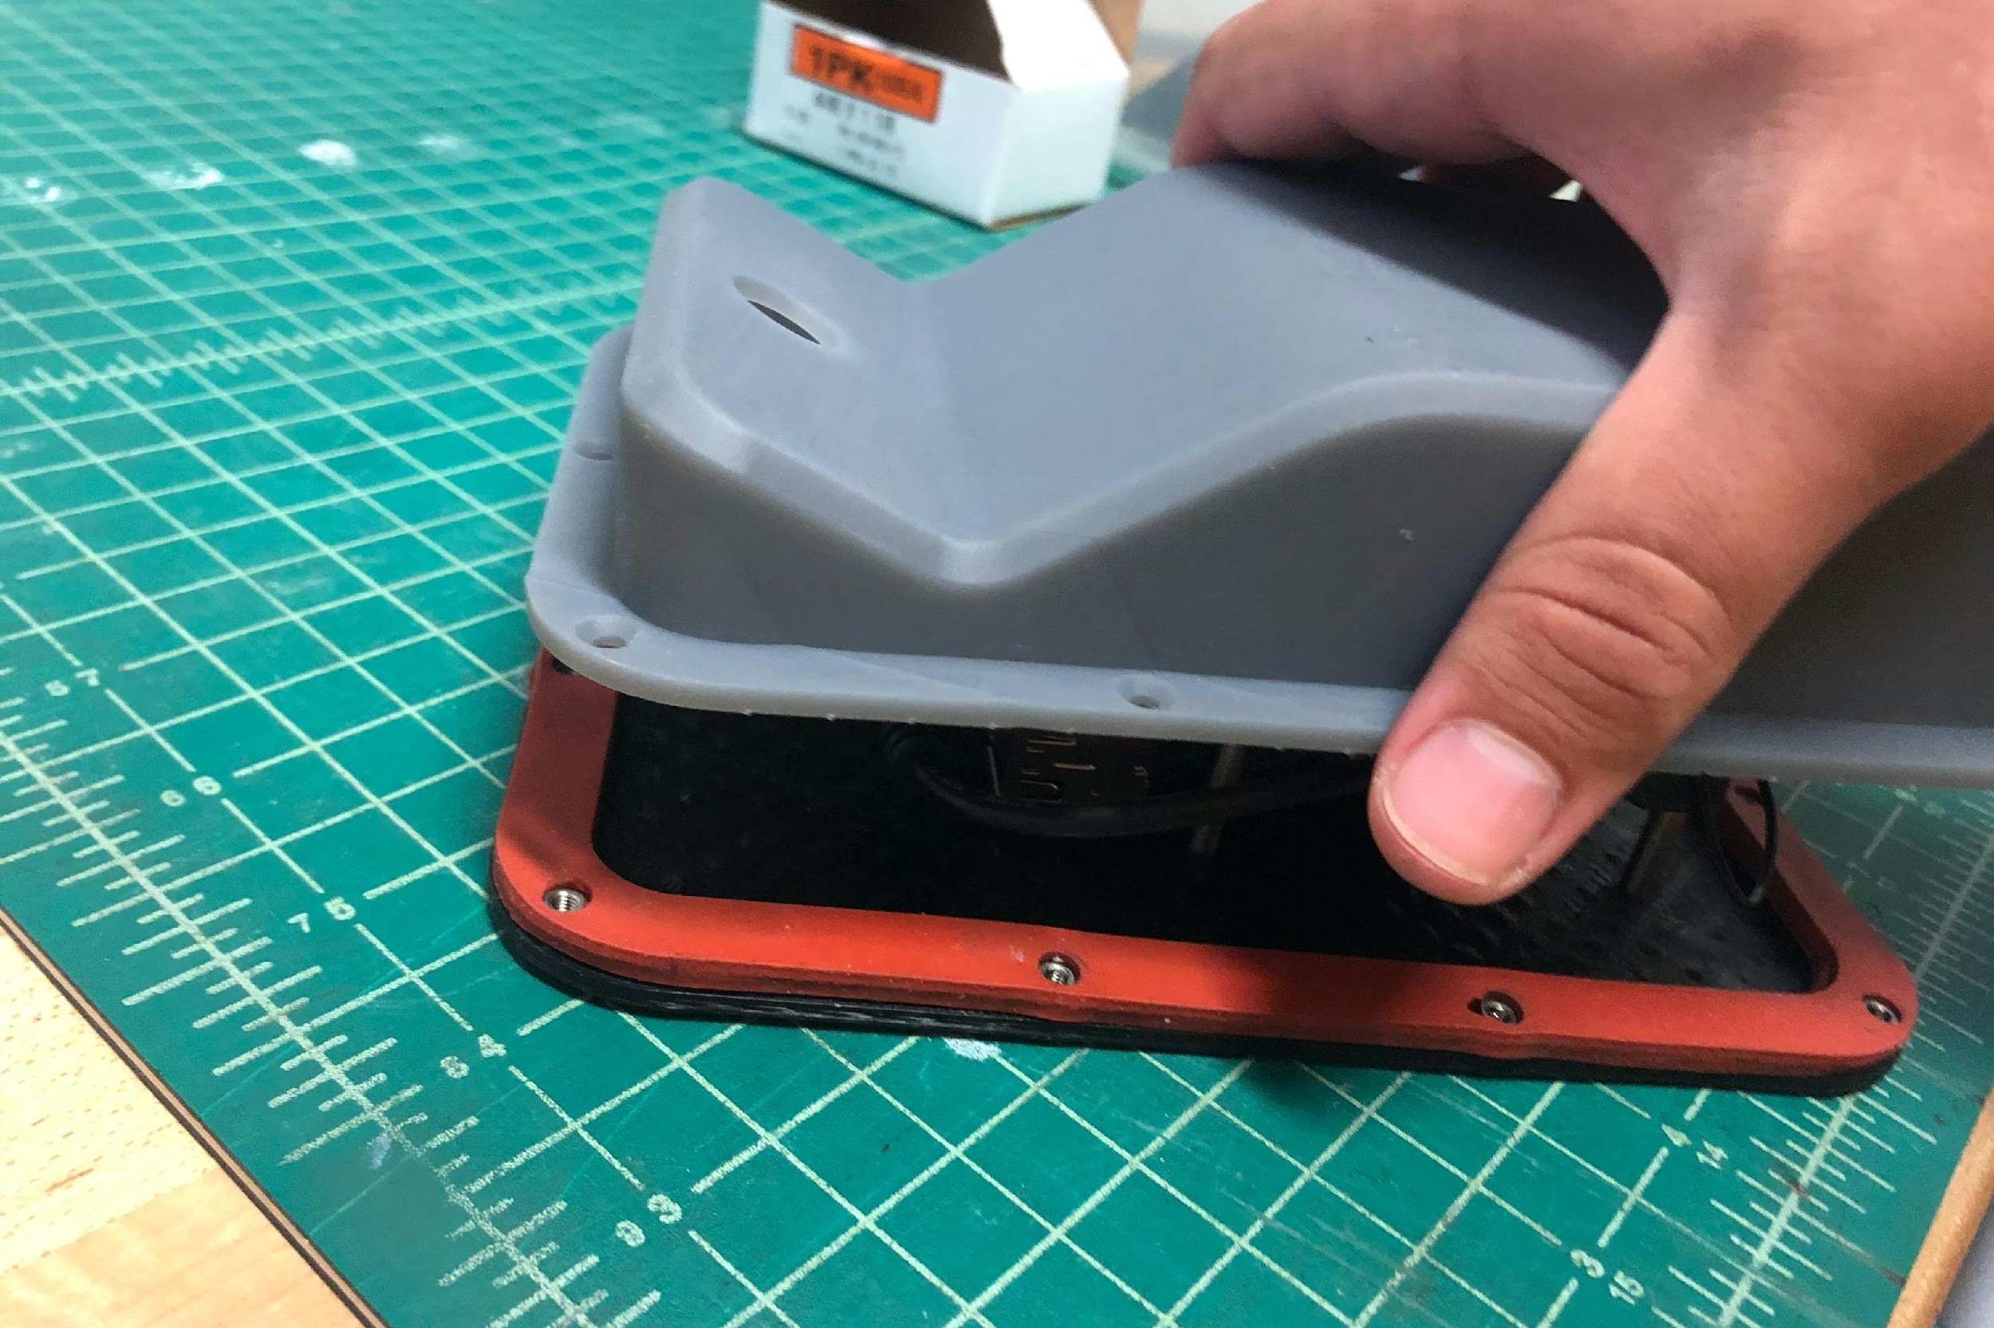
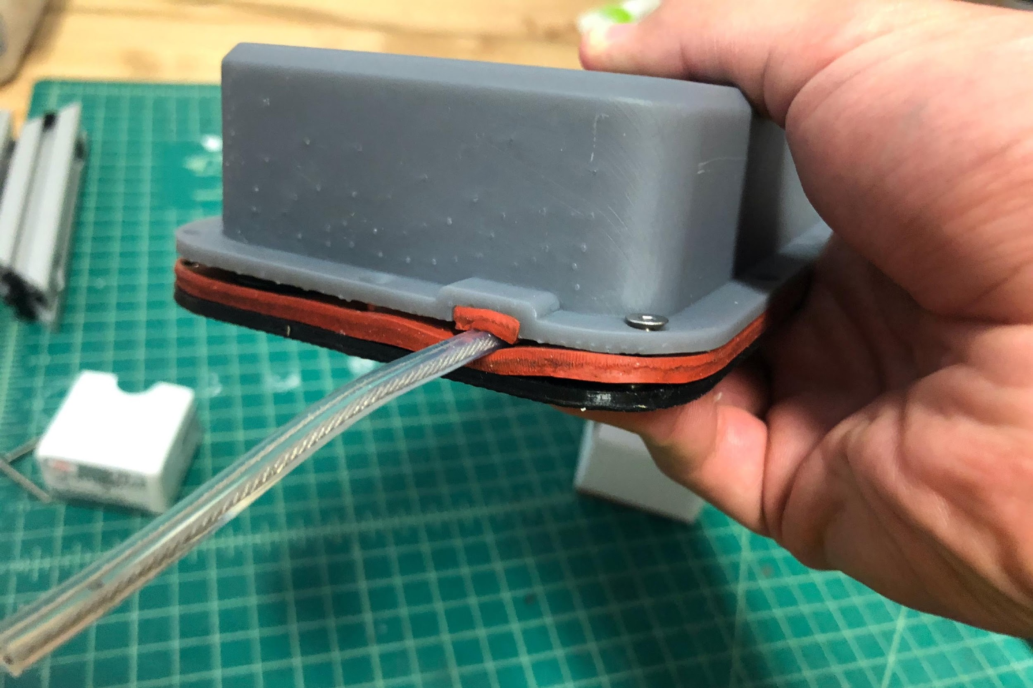
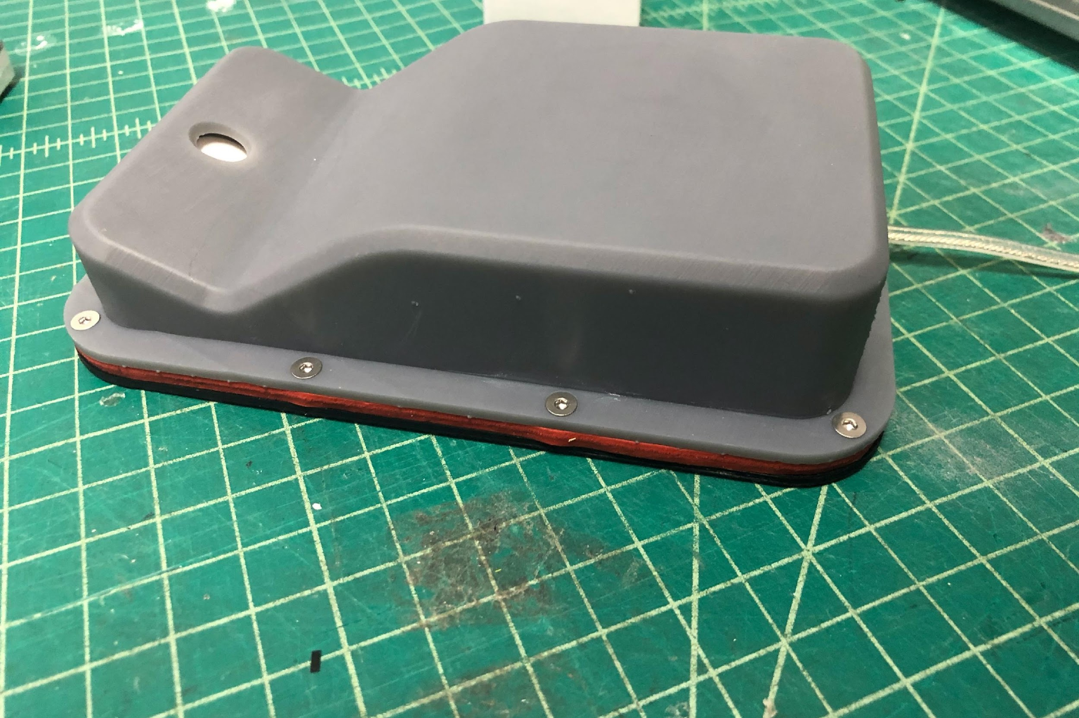
Close housing, keeping power cable between layers of silicone as shown. Screw to close with socket head screws, starting with the two on either side of the power cable.

Slide 25
Pack into box with USB power adaptor, extension cord, and 2 large command strips.
Alternatively, would it be better if we shipped units just wrapped in bubble wrap? High volume when you put each one in a box.

